Slide 1
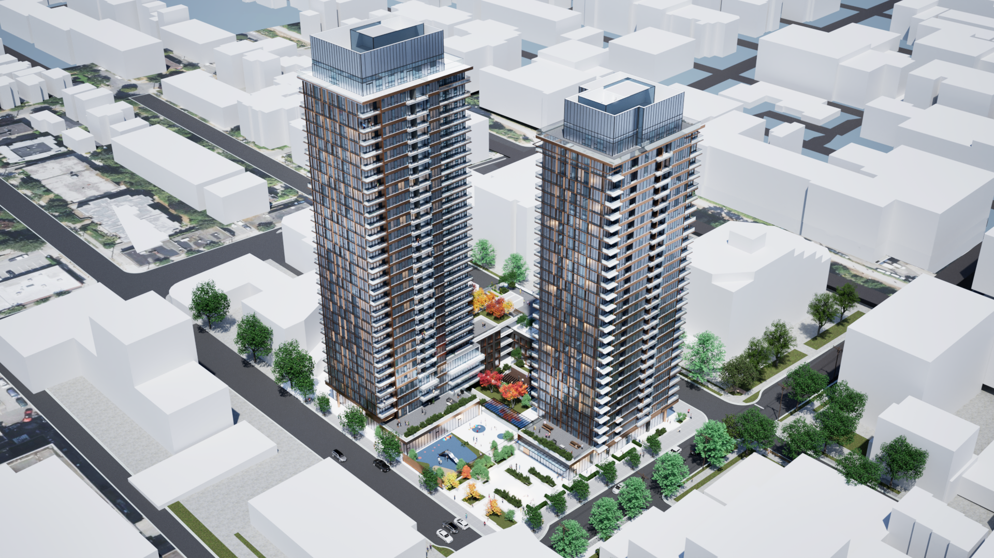
1745 West 8th Avenue
June 2, 2026

Slide 2
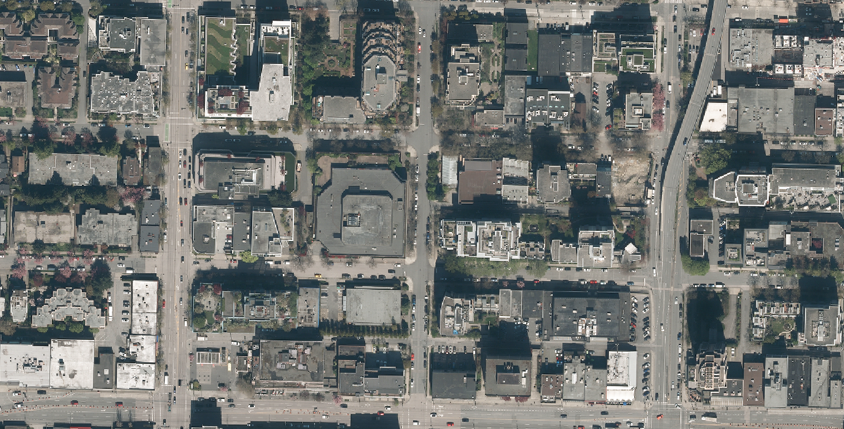


W 6TH AVE
W 7TH AVE
SITE
BURRARD ST
PINE ST
FIR ST
W 8TH AVE
W BROADWAY

Slide 3
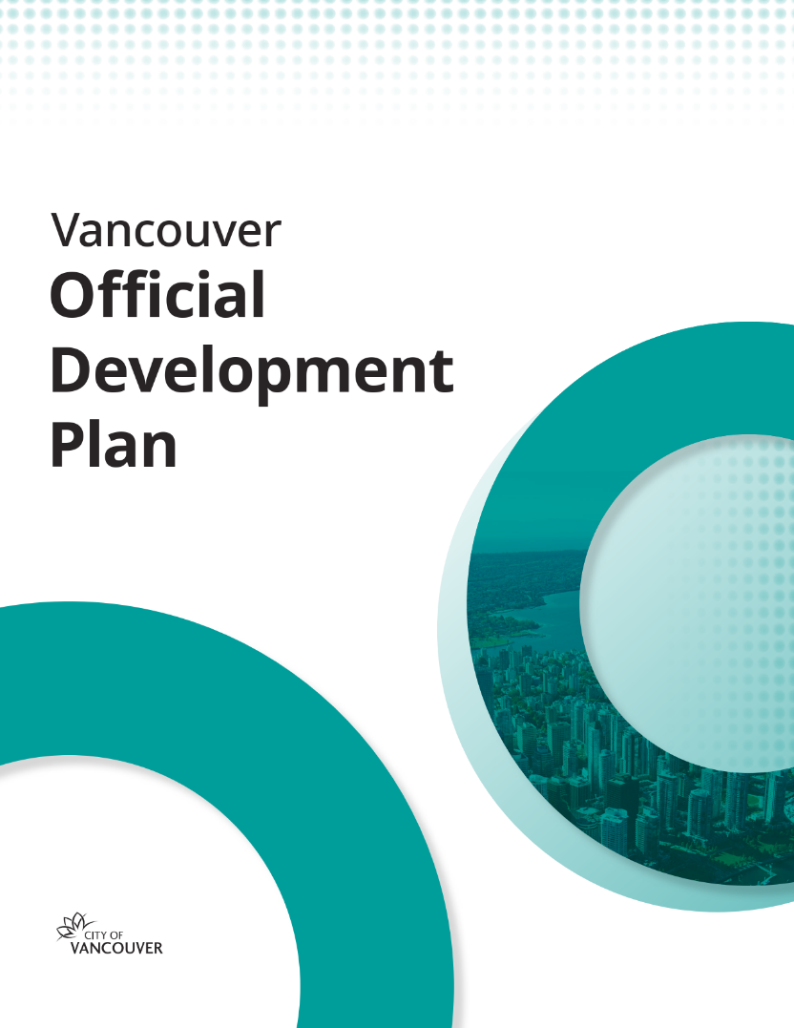
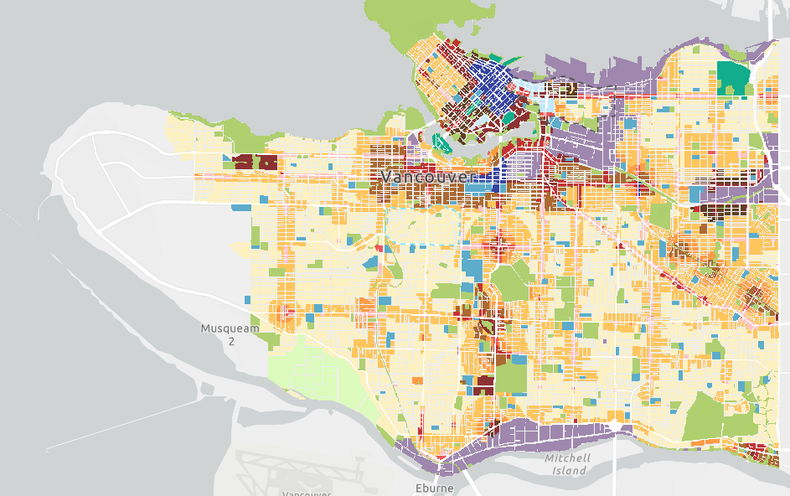
Site
Designated Mixed-Use High-Rise 1

Slide 4
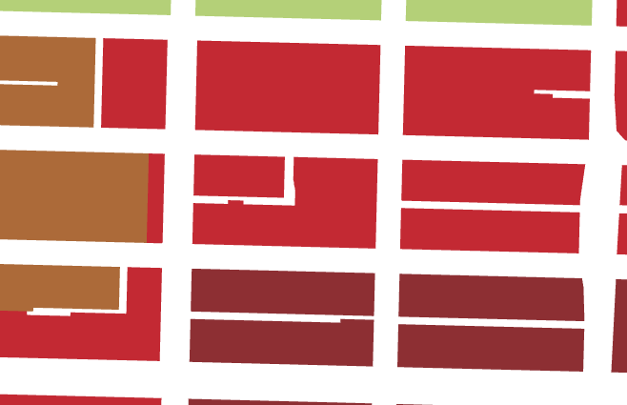

ODP Generalized Land Use Designations
W 6TH AVE
Residential High-Rise 1
Mixed-Use High-Rise 1
W 7TH AVE
Mixed-Use High-Rise 2
SITE
Parks and Open Space
BURRARD ST
PINE ST
FIR ST
Site
W 8TH AVE
W BROADWAY
Amend designation to Mixed-Use High-Rise 2

Slide 5
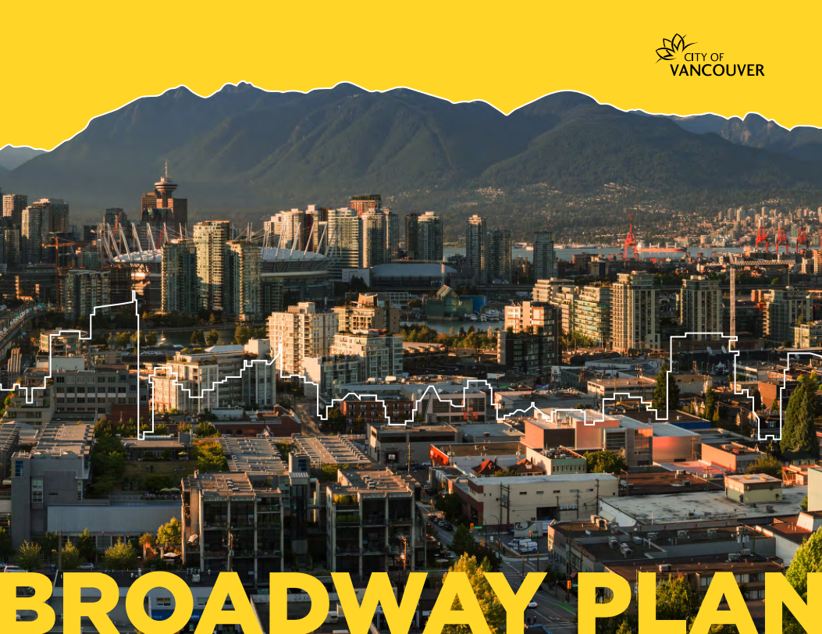
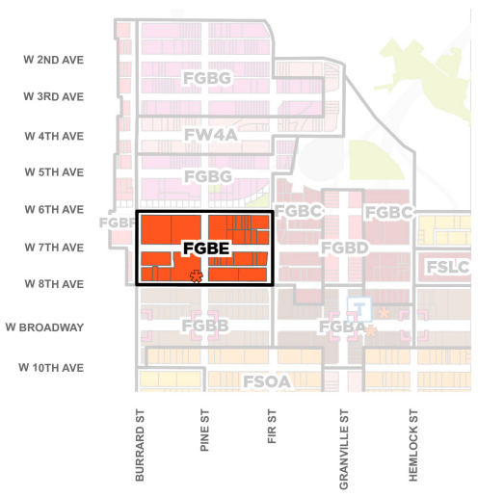
Broadway Plan

Slide 6
Summary
Height | 31 storeys, 102 m (335 ft.) 29 storeys, 92 m (302 ft.)
Density | 8.56 FSR
Land use(s) | Residential, Commercial
Housing | 441 strata units 98 in-kind social housing units
Other details | 37 space in-kind childcare Commercial retail space at grade Privately-Owned Public Space (POPS)
SITE

Slide 7
Consultations required for ODP amendment
Consulted Vancouver School Board (VSB), Conseil scolaire francophone, and Musqueam Indian Band, Squamish Nation and Tsleil-Waututh Nation
VSB noted capacity issues at Kitsilano High School

Slide 8
Support:
Housing
Location
Neighbourhood amenities
Concerns and Responses:
Height
  Generally meets intent of Broadway Plan
  Support delivery of public benefits
Shadowing and views
  No shadows on public schools, parks or high streets, no impacts on protected public views
  Infrastructure
  Broadway Plan Public Benefits Strategy
  Traffic and safety
  In proximity to transit, bike routes
  New sidewalks along frontages

Slide 9
TOTAL
$70 M
CAC (In-kind)
$57 M*
Public Art
$0.8 M
DCLs
$12 M
*In-kind public benefits
Social housing | 98 units ($51M)
Childcare | 37 spaces ($6M)
Other public benefits
Privately-Owned Public Space
Notes:
Customize slide as needed (change smart graph, list public benefits, or etc.)

Slide 10
1745 West 8th Avenue
Staff support, subject to Appendix C
June 2, 2026

