Slide 1
2108 & 2408 Cassiar St (Skeena Terrace) Rezoning City of Vancouver Public Hearing
Sheryl Peters, Provincial Director – Redevelopment, Development & Asset Strategies.
Thomas Bevan, Development Manager – Redevelopment, Development & Asset Strategies
March 12, 2024

Slide 2
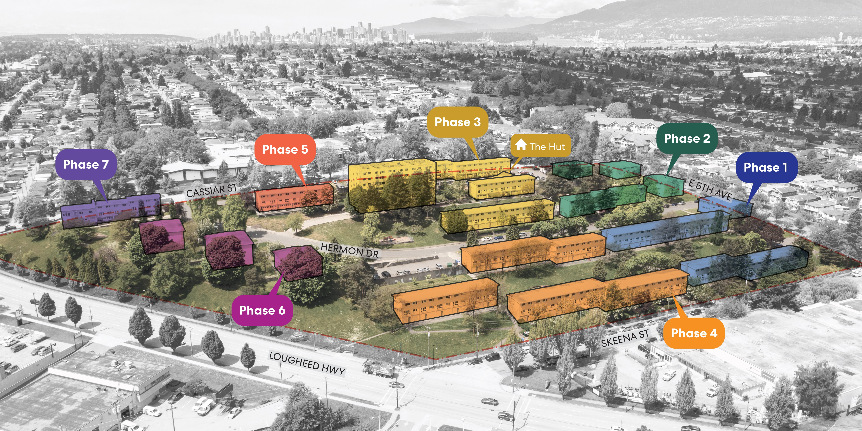
Site Phasing

Slide 3
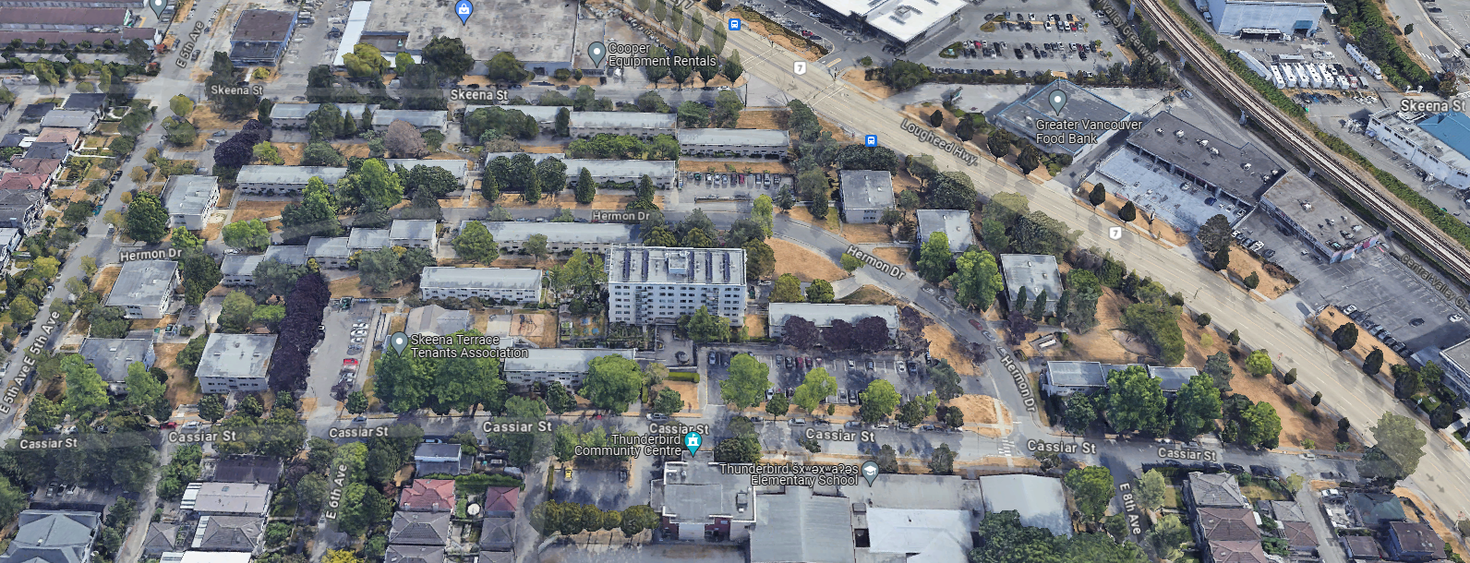
Current Skeena Terrace

Slide 4
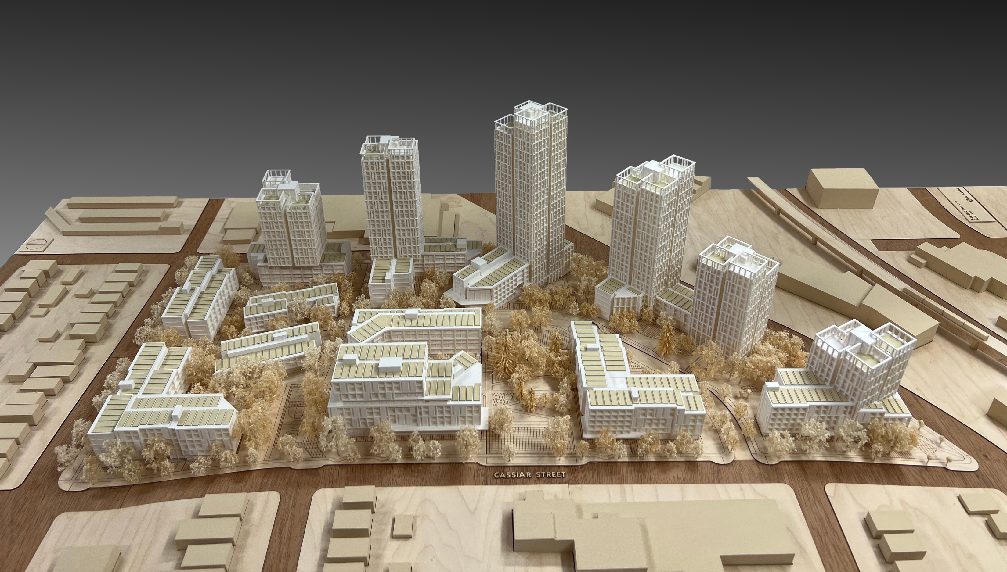
Future Skeena Terrace

