Slide 1
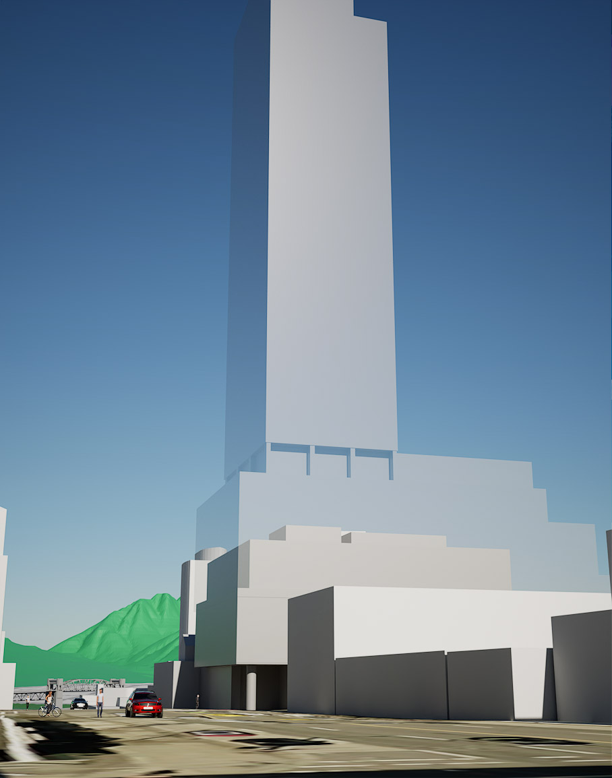
1477 West Broadway
Stephen Bohus, BLA
Vancouver resident & renter
Rendering depicts massing model of tower rezoning (transparent) and approved development permit (solid)

Slide 2
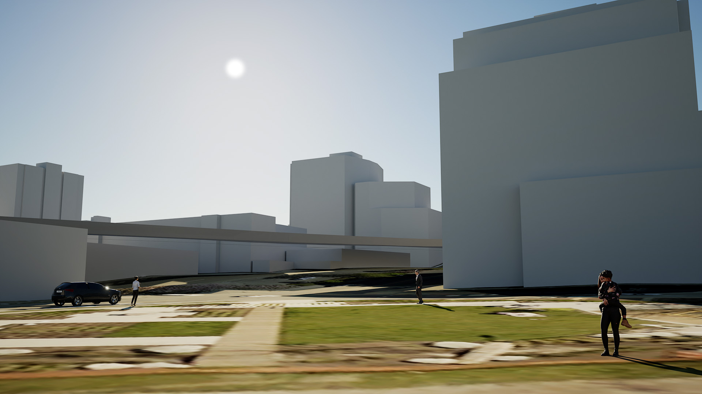
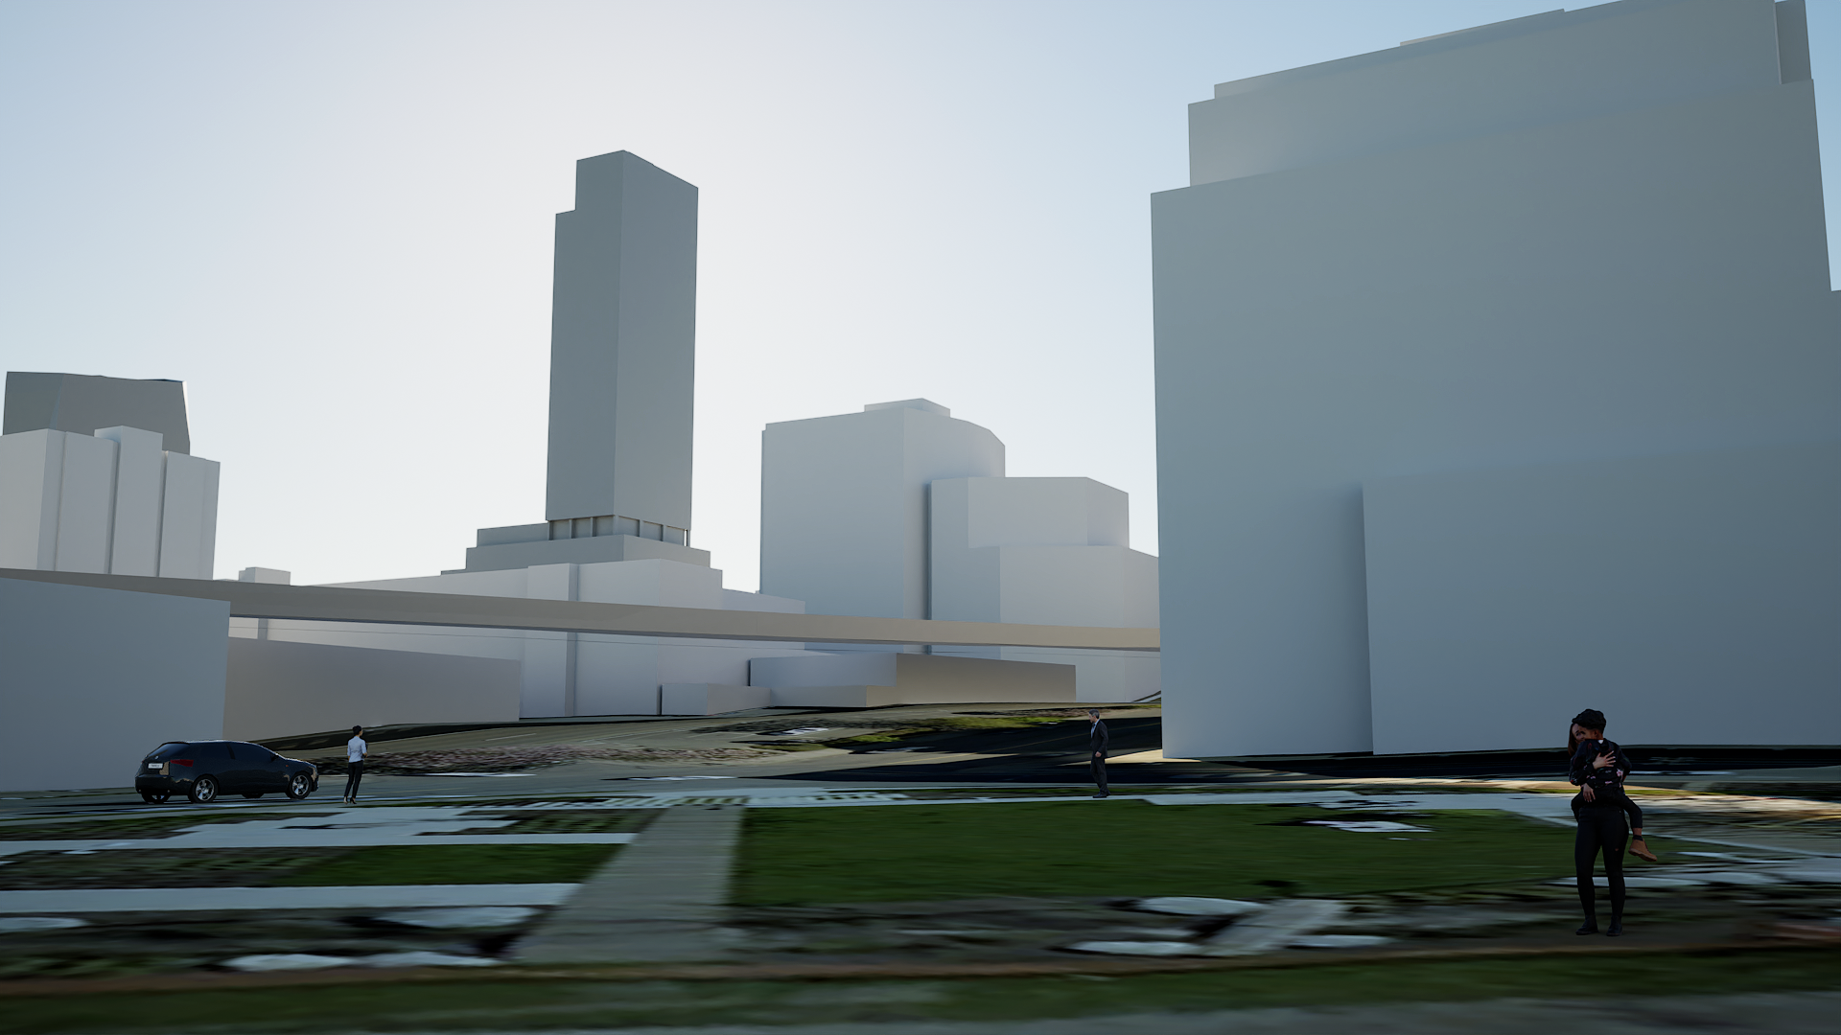
Public Consultation
Renderings submitted during consultation phase on Dec 5, 2021
October 28, 10:30am before (current) and after (with rezoning proposal)

Slide 3
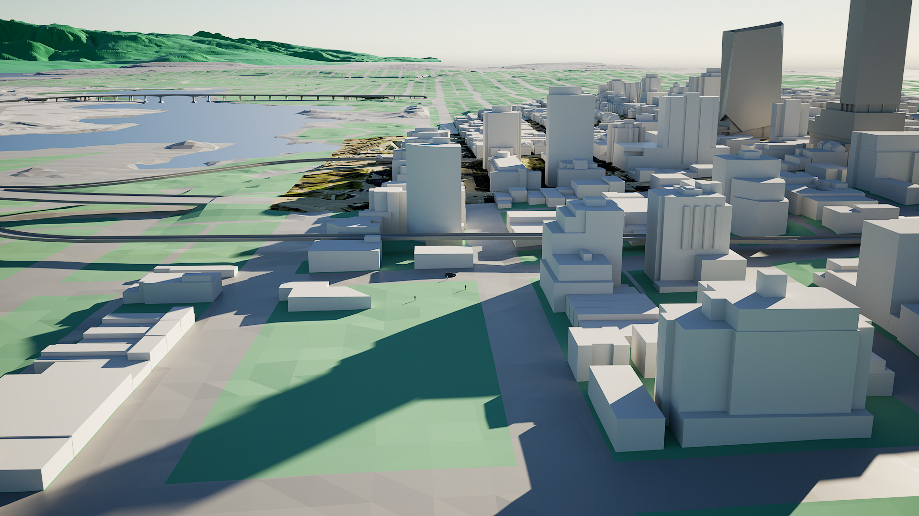
Rendering submitted during consultation phase on Dec 5, 2021
Future Burrard Slopes Park at Oct 29, 9:55am
Rendering of massing model and shadows (1477 W Broadway)

Slide 4
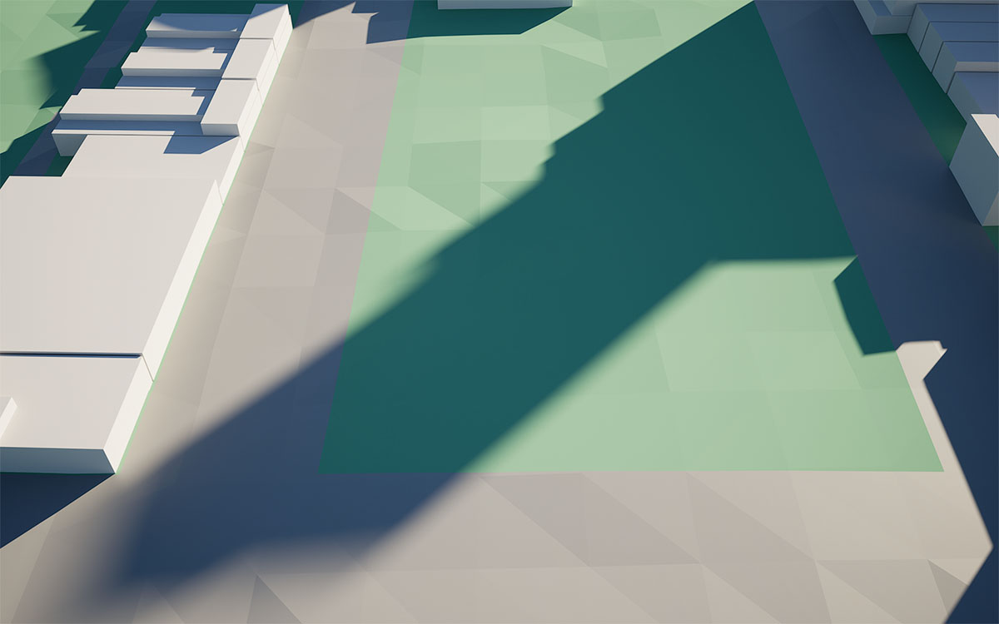
Future Burrard Slopes Park on Oct 29, 9:55am
Rendering of massing model and shadows (Pine & W 5th Avenue to Fir & W 6th Ave)

Slide 5
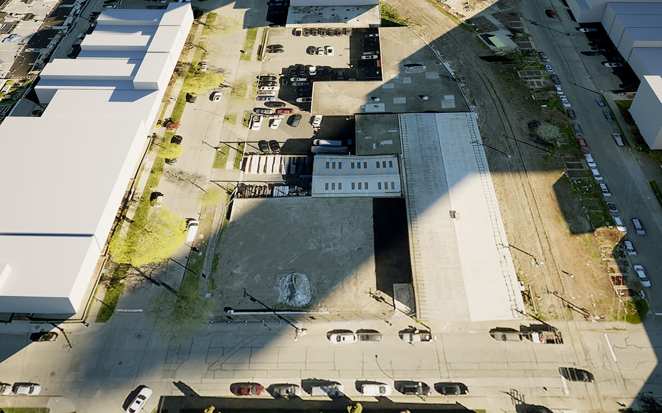
Future Burrard Slopes Park on Oct 29, 9:55am
Rendering of massing model and shadows (Pine & W 5th Avenue to Fir & W 6th Ave)

Slide 6
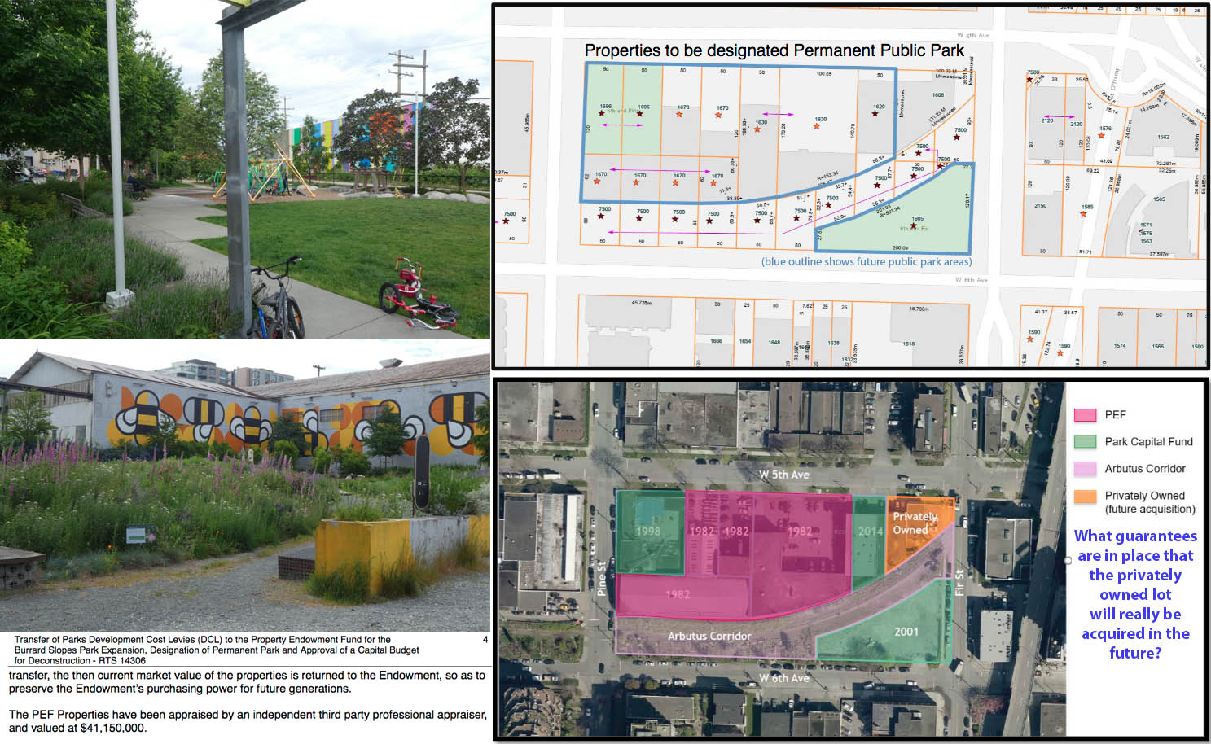
Council spent $41.6 million on Burrard Slopes Park on June 9th, 2021
Buildings on park site to be demolished, park will undergo redesign
https://council.vancouver.ca/20210609/documents/cfsc2.pdf

Slide 7
Future Burrard Slopes Park on Oct 29, 10:30am
Rendering of massing model and shadows (Fir & W 6th Ave)

Slide 8
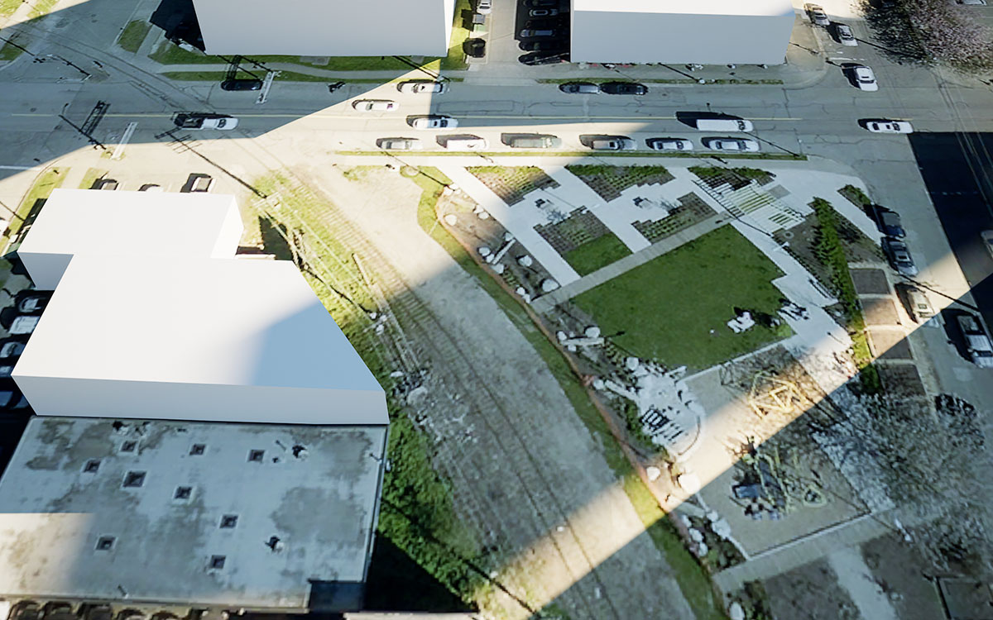
Existing ‘6th and Fir Park’ on Oct 29, 10:30am
Rendering of massing model and shadows (Fir & W 6th Ave)

Slide 9
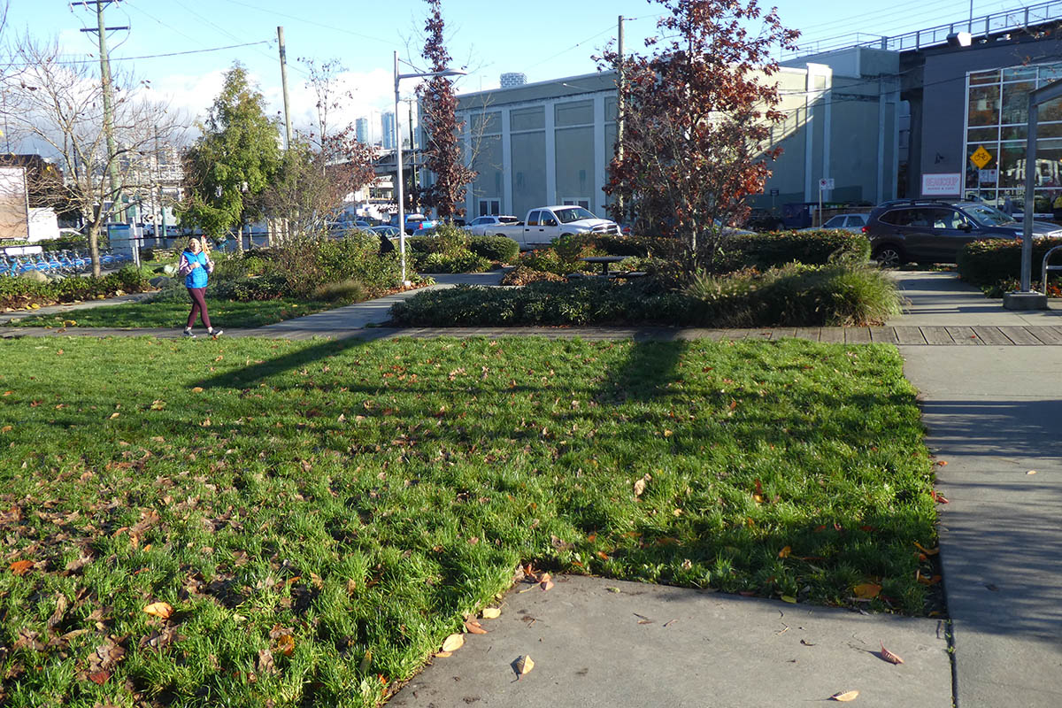
Existing ‘6th and Fir Park’ on Oct 29, 10:30am
Photo shows sunlight in park (Fir & W 6th Ave)

Slide 10
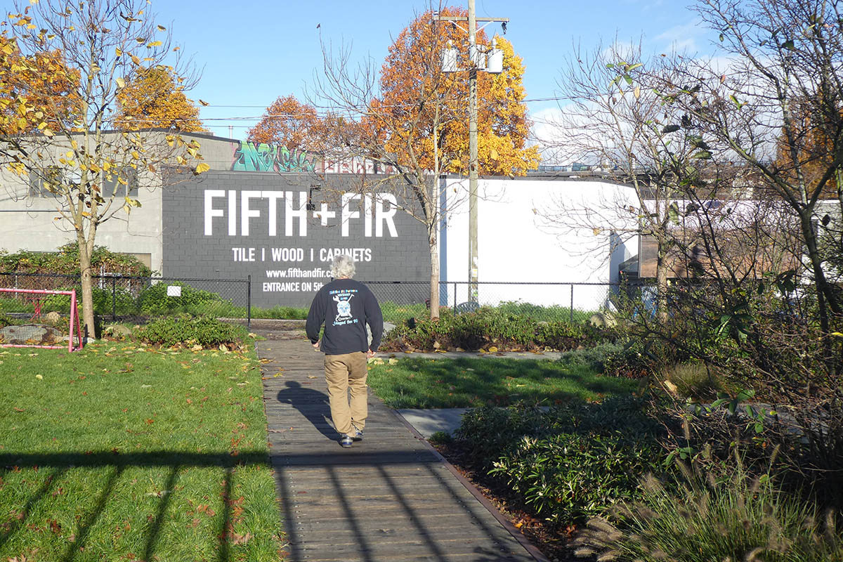
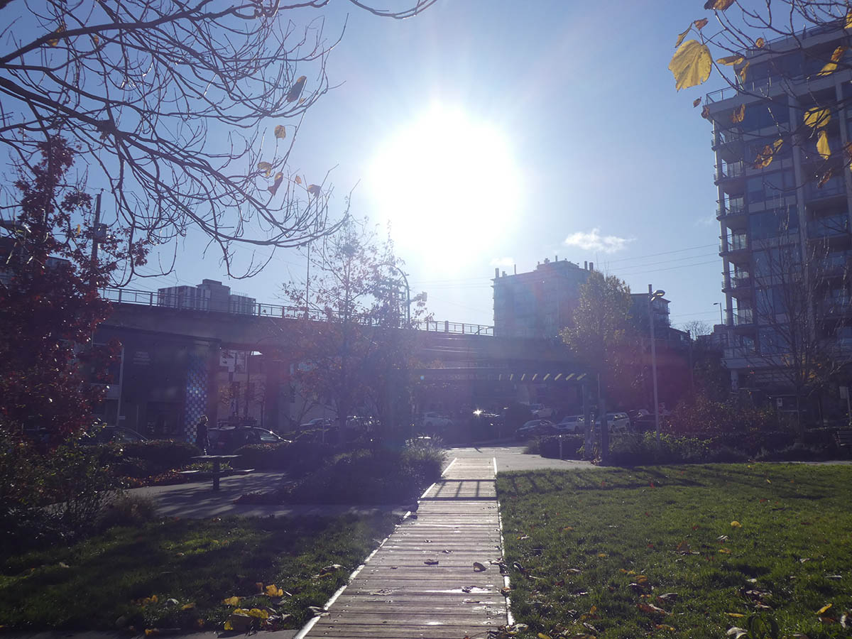
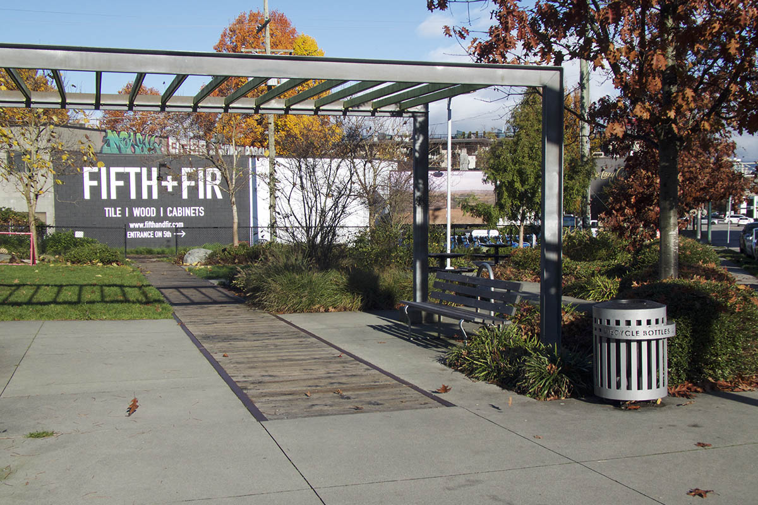
Existing ‘6th and Fir Park’ on Oct 29 around 10:35am
Photo shows sunlight in park (Fir & W 6th Ave)

Slide 11
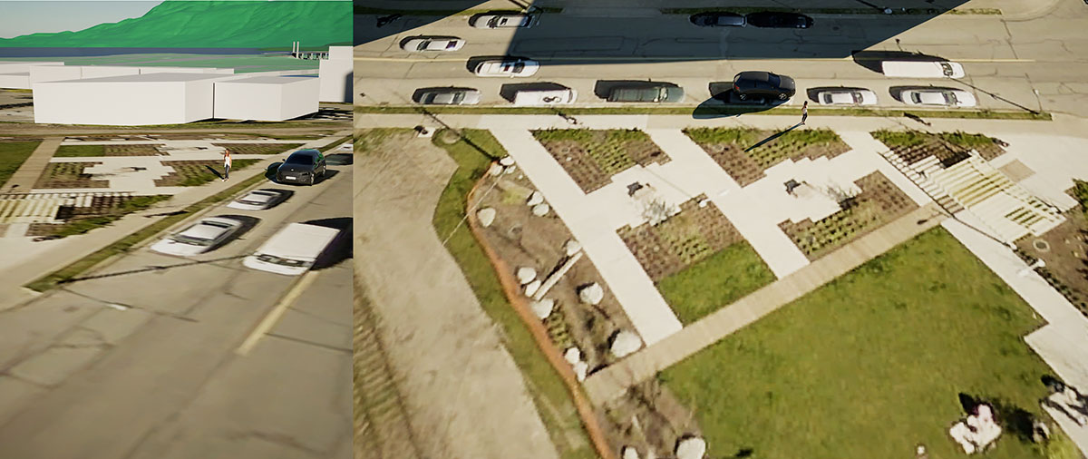
Existing ‘6th and Fir Park’ on Oct 29, 10:35am
Rendering of current building model and shadows (Fir & W 6th Ave)

Slide 12
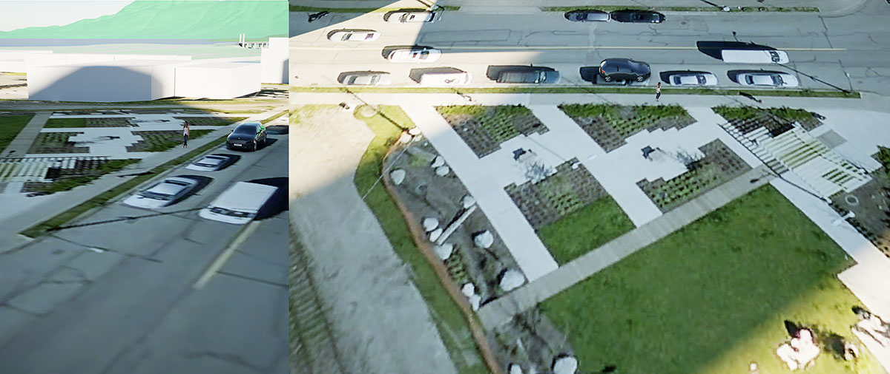
Existing ‘6th and Fir Park’ on Oct 29, 10:35am
Rendering includes shadows from 1477 W Broadway rezoning (Fir & W 6th Ave)

Slide 13
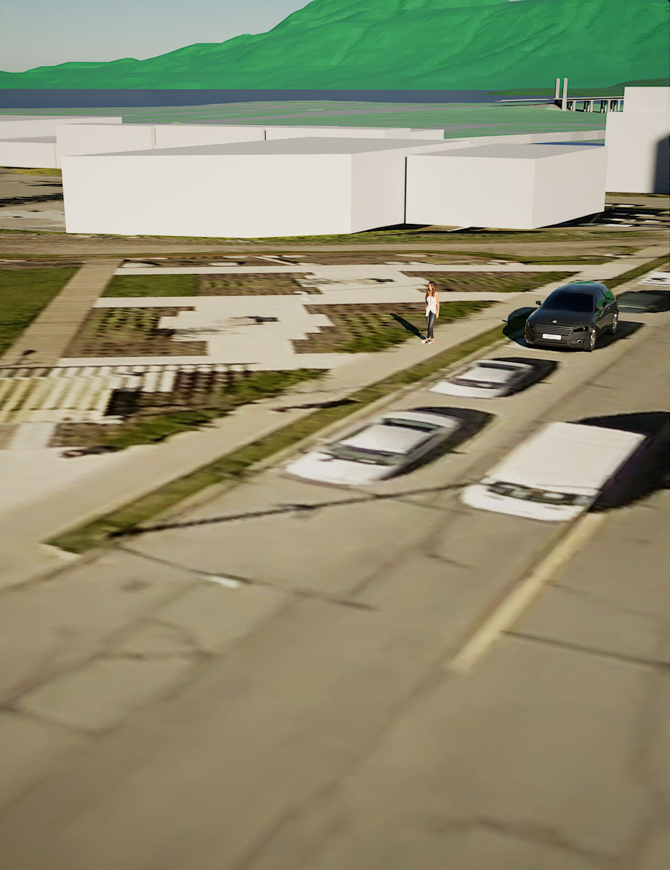
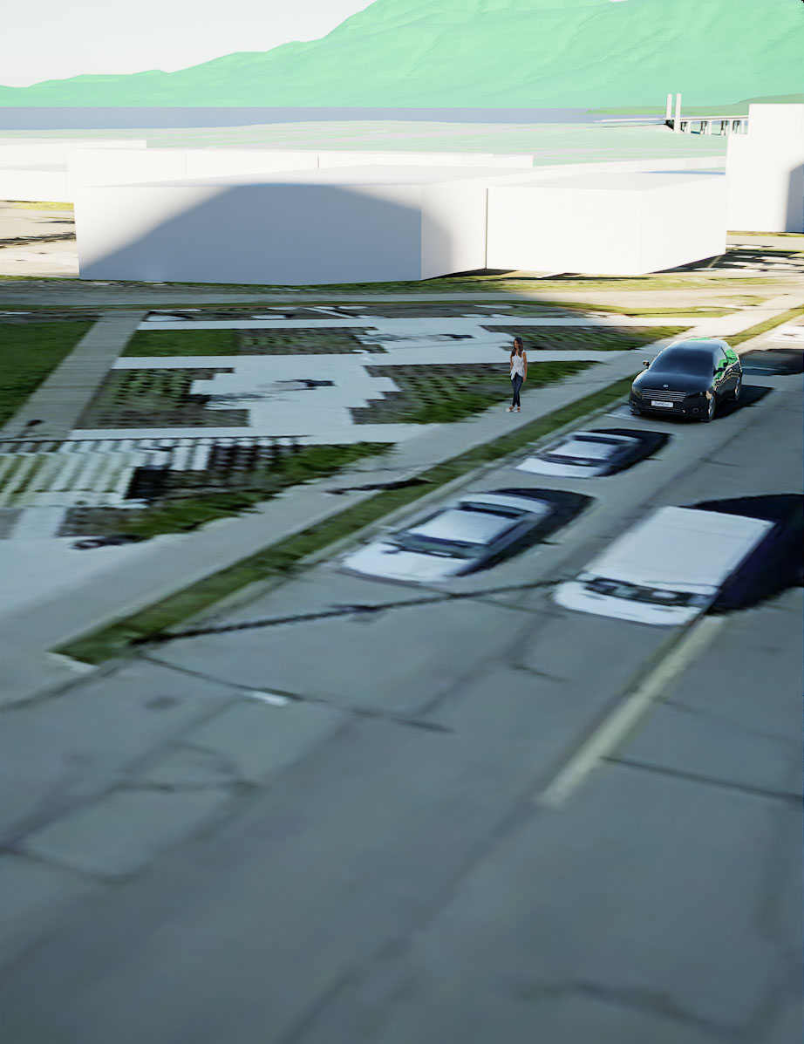
Before and after ‘6th and Fir Park’ on Oct 29, 10:35am
Rendering of massing model and shadows (Fir & W 6th Ave)

Slide 14
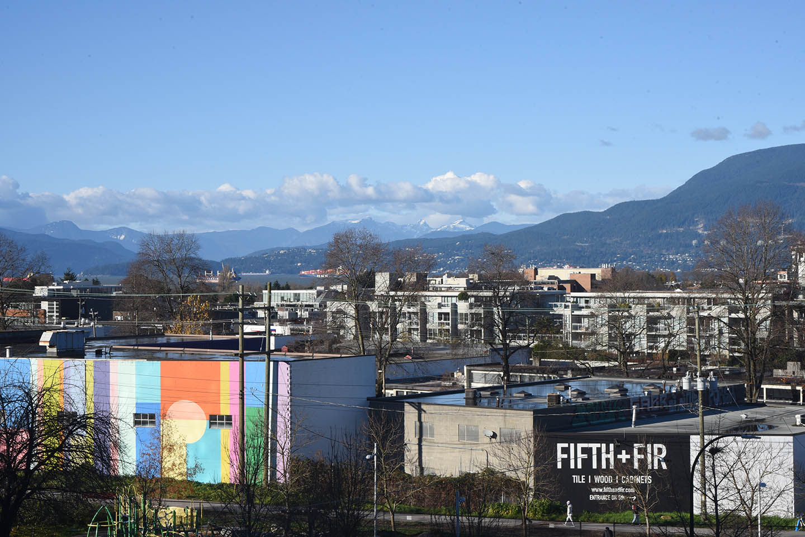
Overview of future park site from Fir Street (off ramp)
Photo of future Burrard Slopes Park (building left to be demolished)

Slide 15
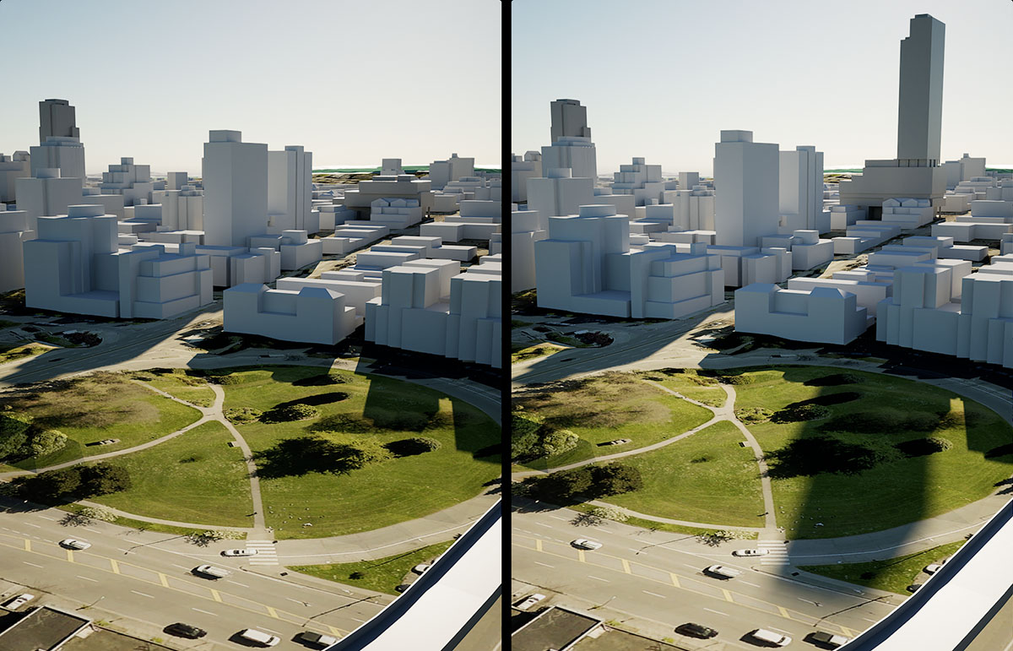
Greenspace at West 4th and Granville (Southwest Granville Loop)
Before and after comparison of massing model & shadows (Nov 28th 11am)

Slide 16
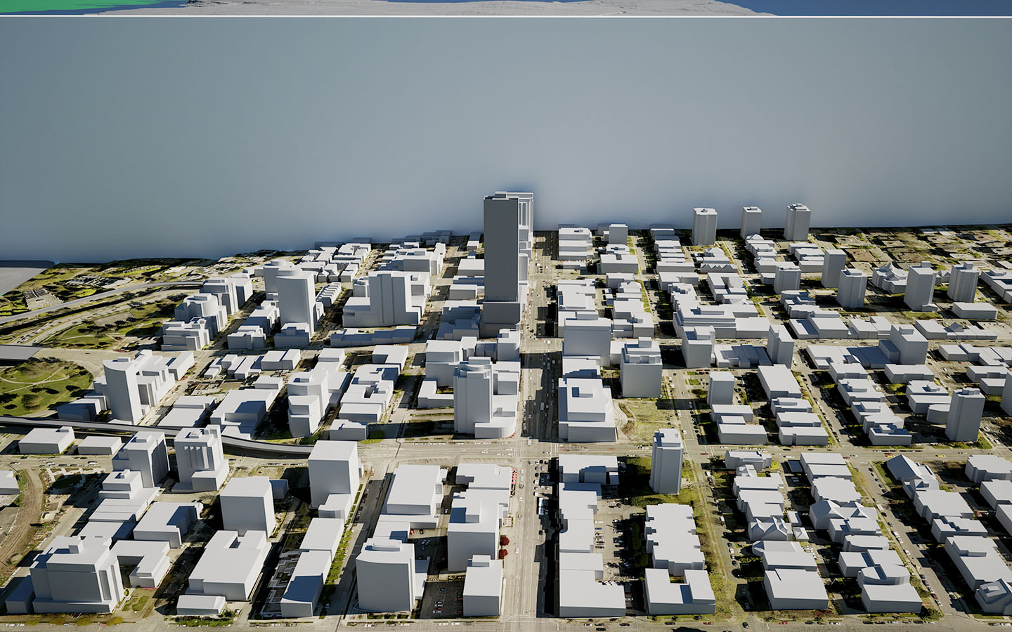
Section show topographic changes & north facing slope
Shadows on Oct 21, 12:45pm (Fairview Slopes, Burrard Slopes)

Slide 17
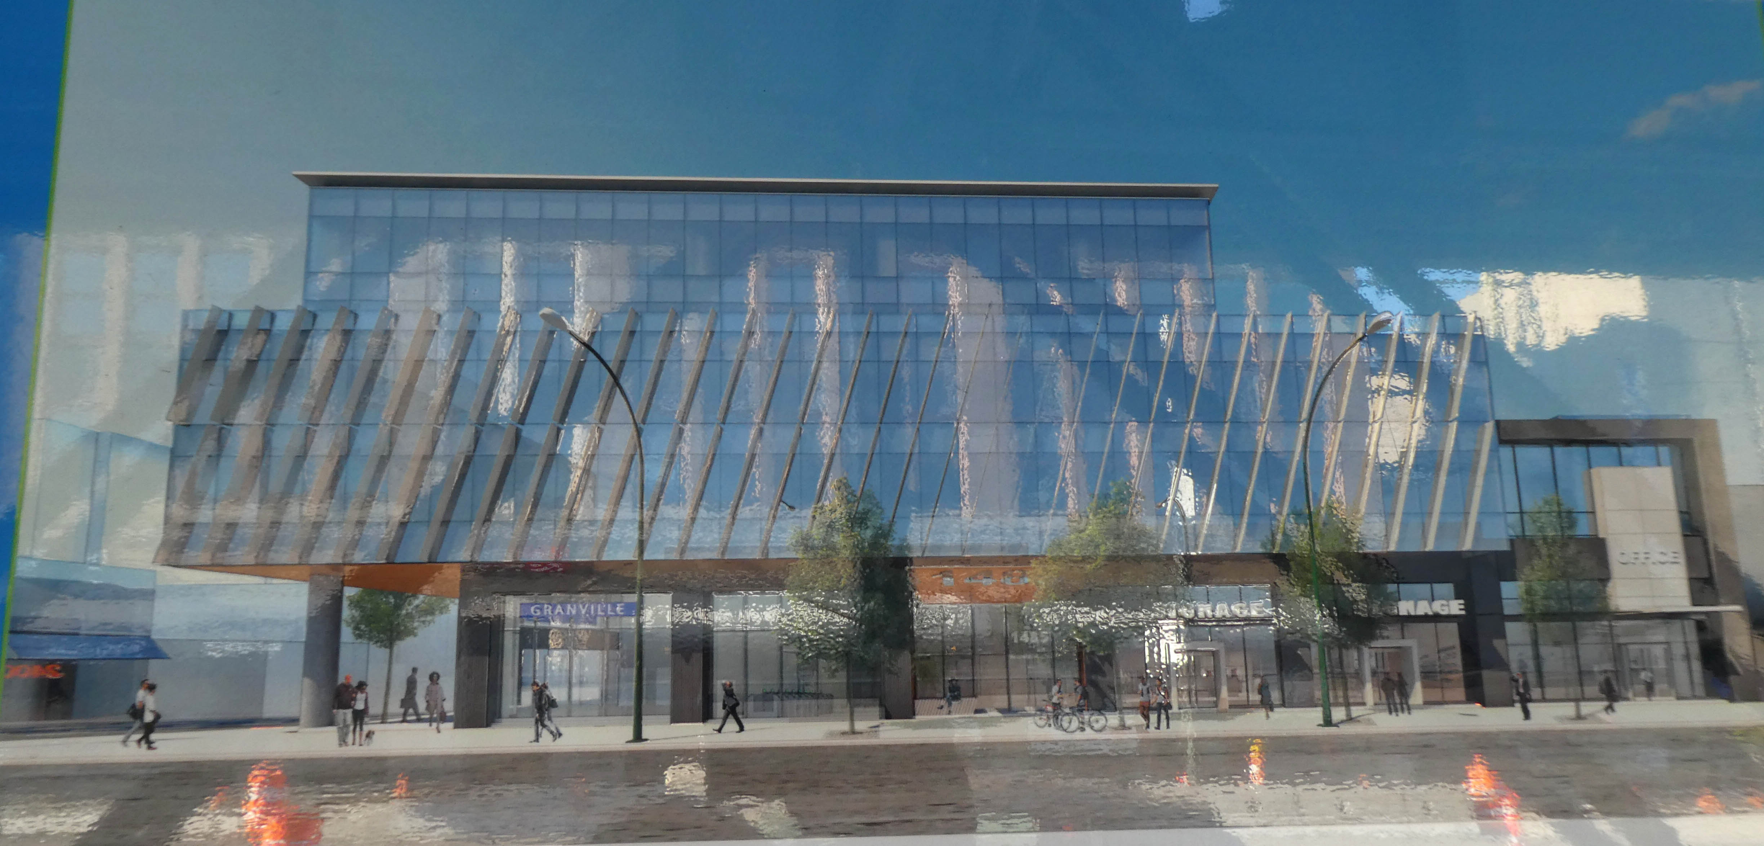
Already approved development permit for 1477 West Broadway 3 FSR, office uses
Rendering from Development Permit Sign posted on Granville Street

Slide 18
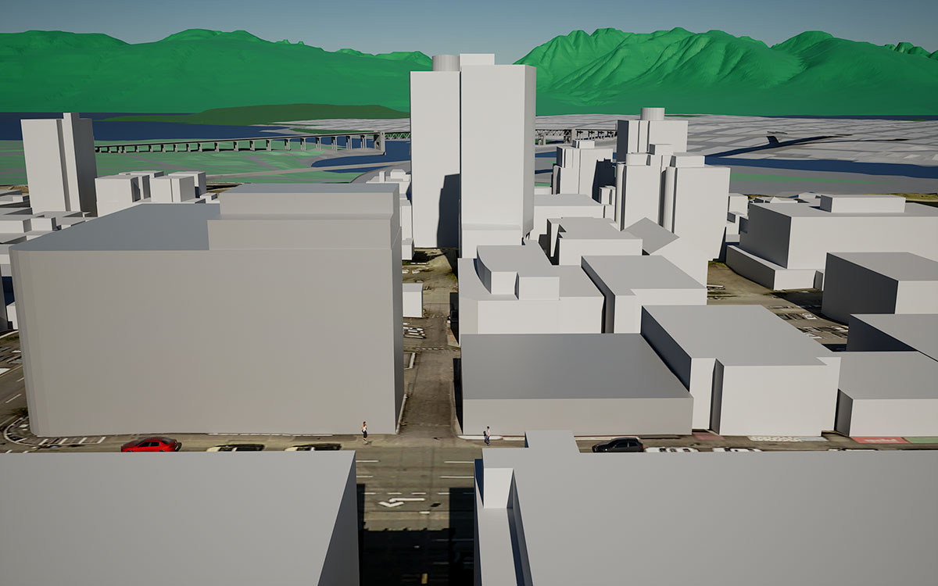
Comparison of site massing RBC (laneway and adjacent building)
Shadows on Oct 21, 12:45pm. Laneway was City-owned

Slide 19
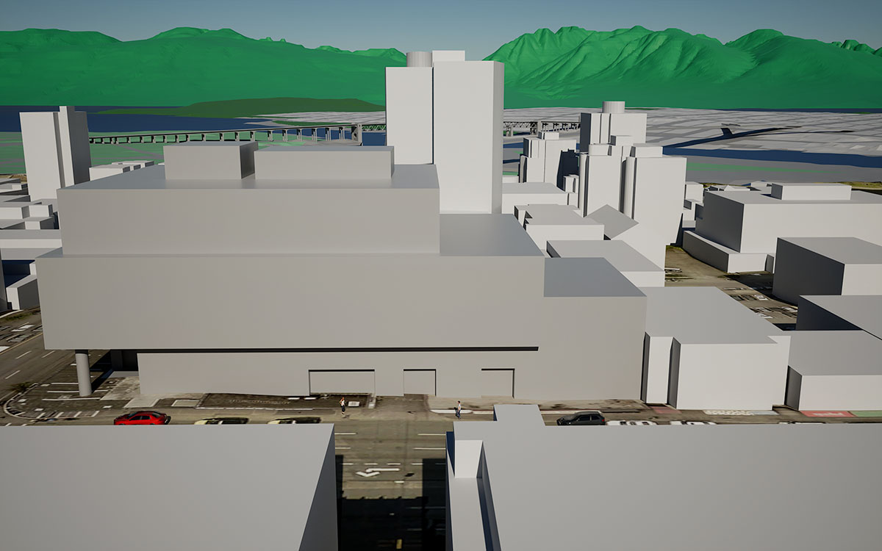
Comparison of site massing approved Development Permit
Shadows on Oct 21, 12:45pm

Slide 20
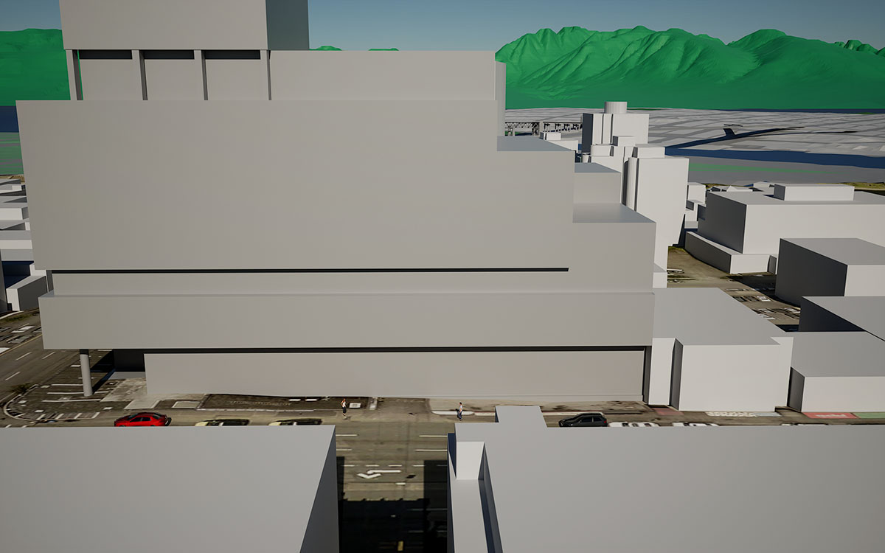
Comparison of site massing rezoning application
Shadows on Oct 21, 12:45pm

Slide 21
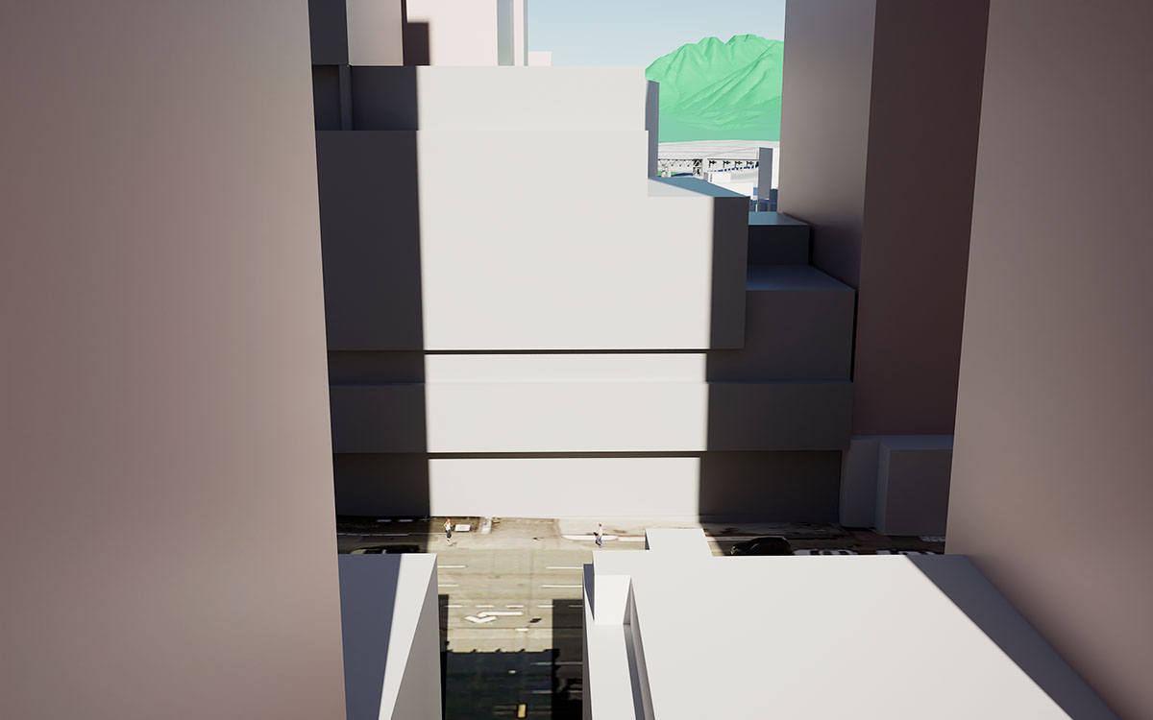
Possible buildout scenario in the future
Shadows on Oct 21, 12:45pm

Slide 22
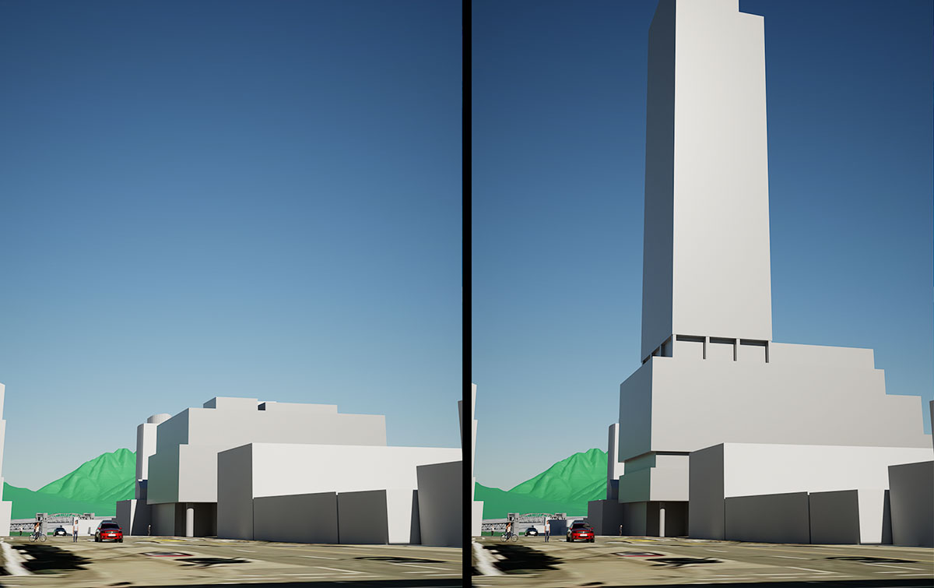
Comparison of DP massing and rezoning application
Granville Street looking north. Shadows on Oct 21, 12:45pm

Slide 23
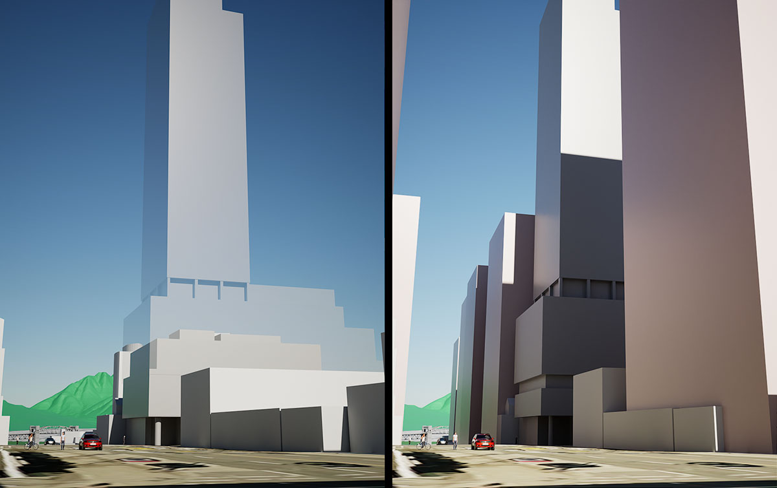
Comparison of DP, rezoning (transparent) and possible buildout
Granville Street looking north. Shadows on Oct 21, 12:45pm

Slide 24
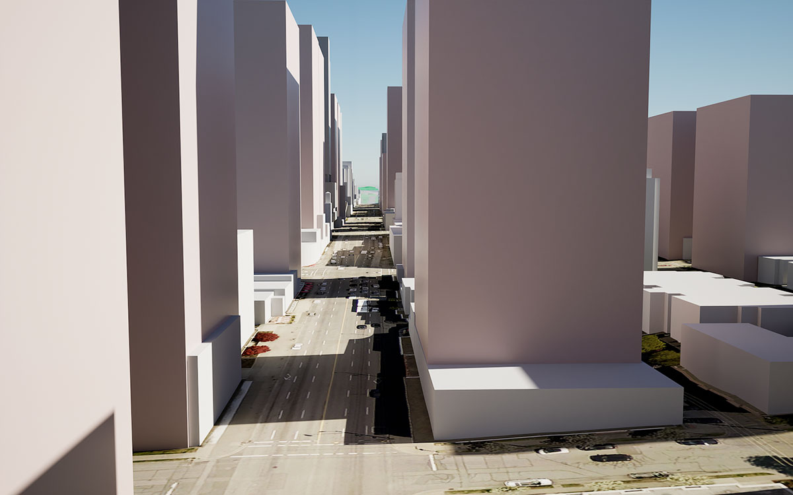
A possible future buildout?
Broadway, shadows on Oct 21, 12:45pm

Slide 25
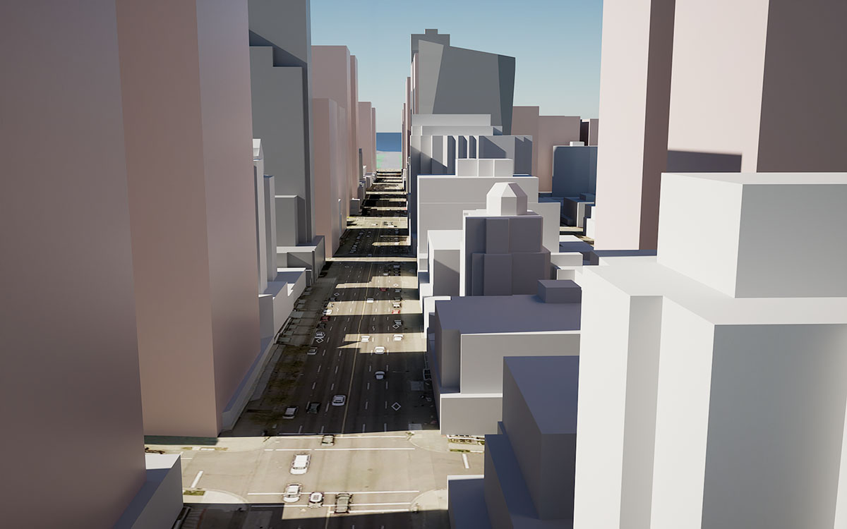
A possible future buildout?
Broadway, shadows on Oct 21, 12:45pm

Slide 26
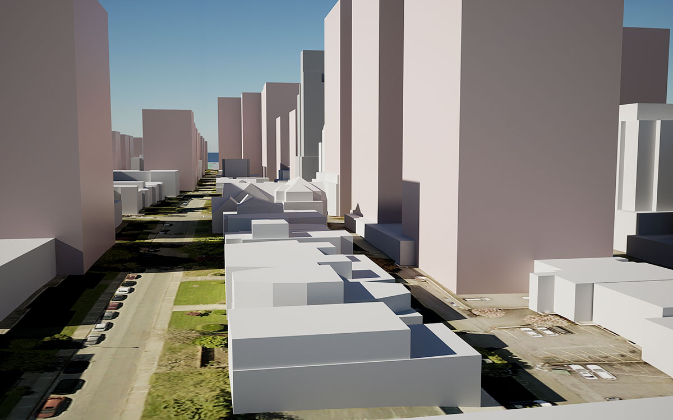
A possible future buildout?
West 10th Avenue, shadows on Oct 21, 12:45pm

Slide 27
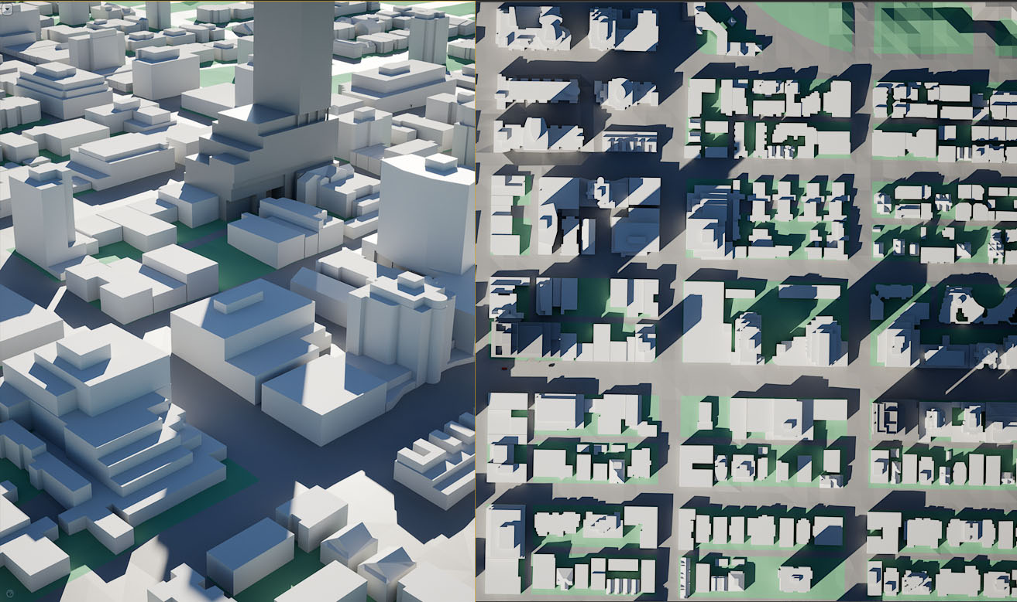
Shadows in 3D and plan
September 30th 4pm

Slide 28
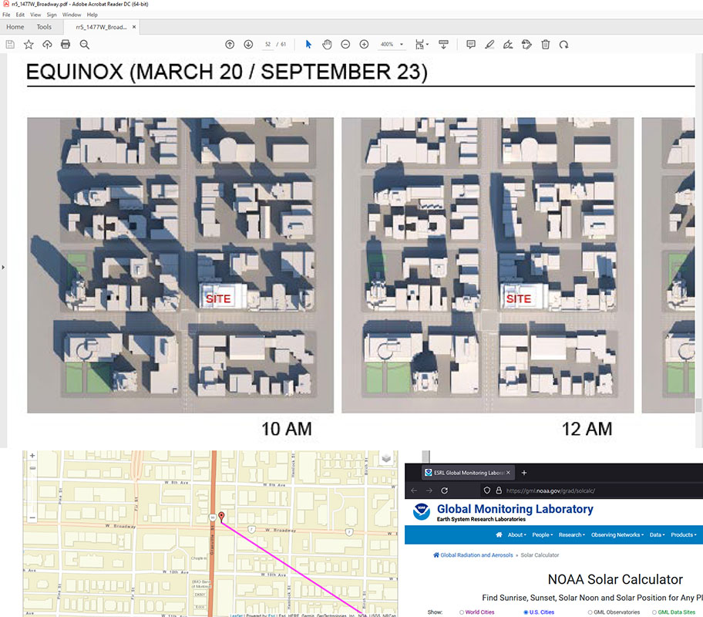
Shadow diagrams on Policy report. Compare with NOAA Solar Calculator

Slide 29
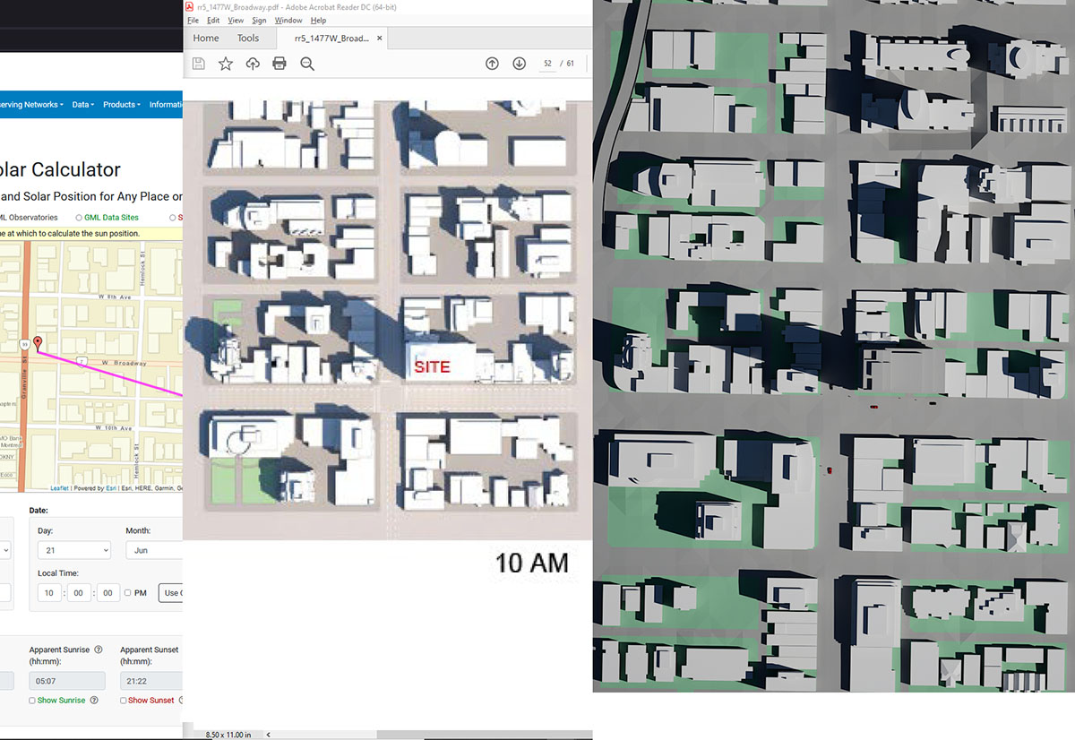
Shadow diagrams on Policy Report (Appendix D Page 9 of 9)
June 21 at 10am. Compare NOAA, Policy Report and independently generated shadow diagram

Slide 30
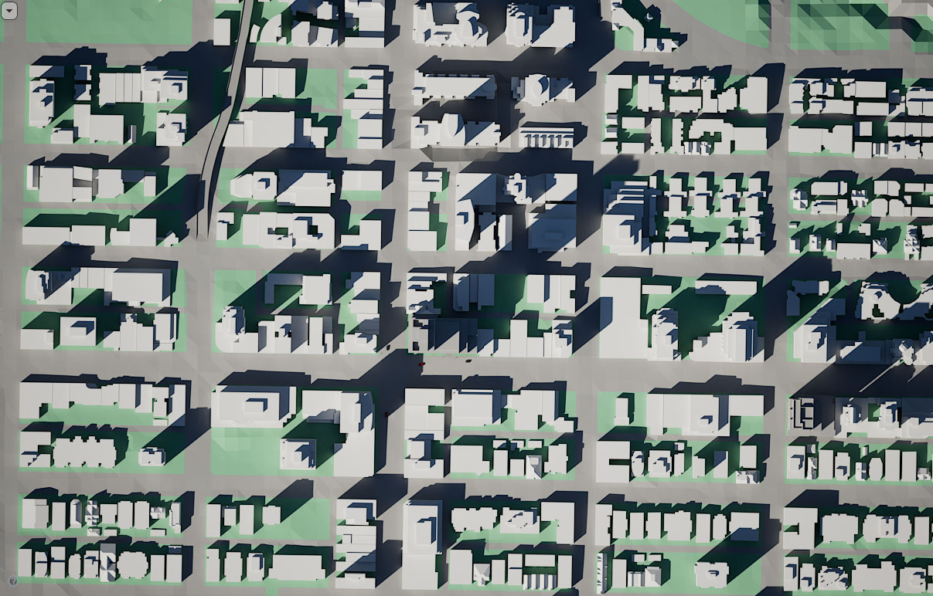
Shadow diagrams
September 21 at 4pm

Slide 31
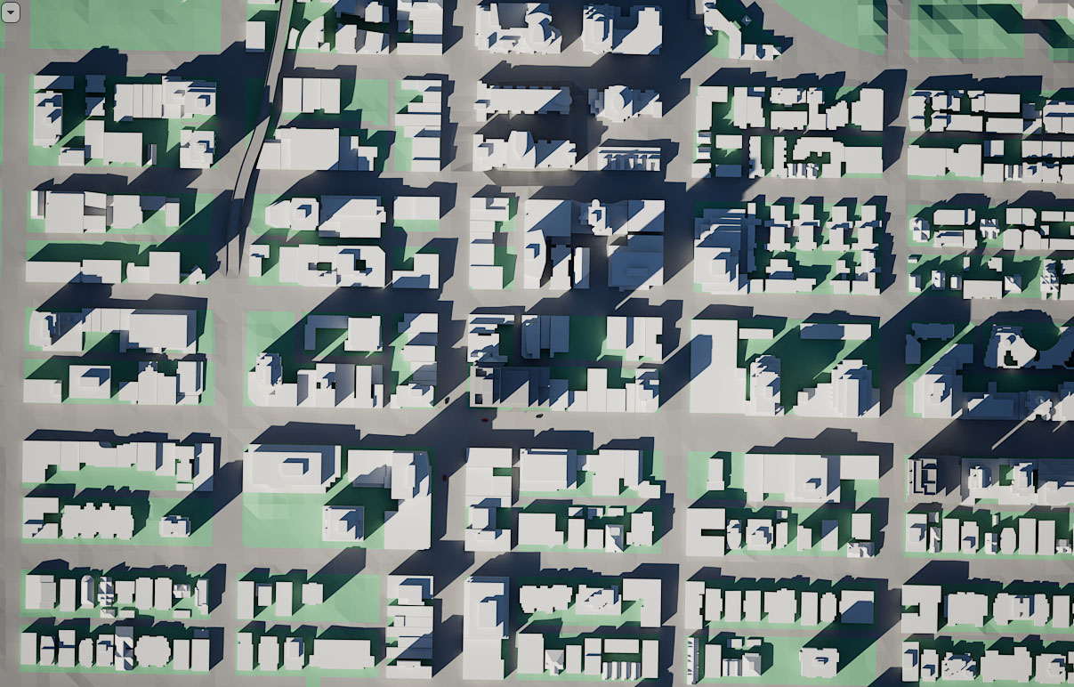
Shadow diagrams
September 30 at 4pm

Slide 32
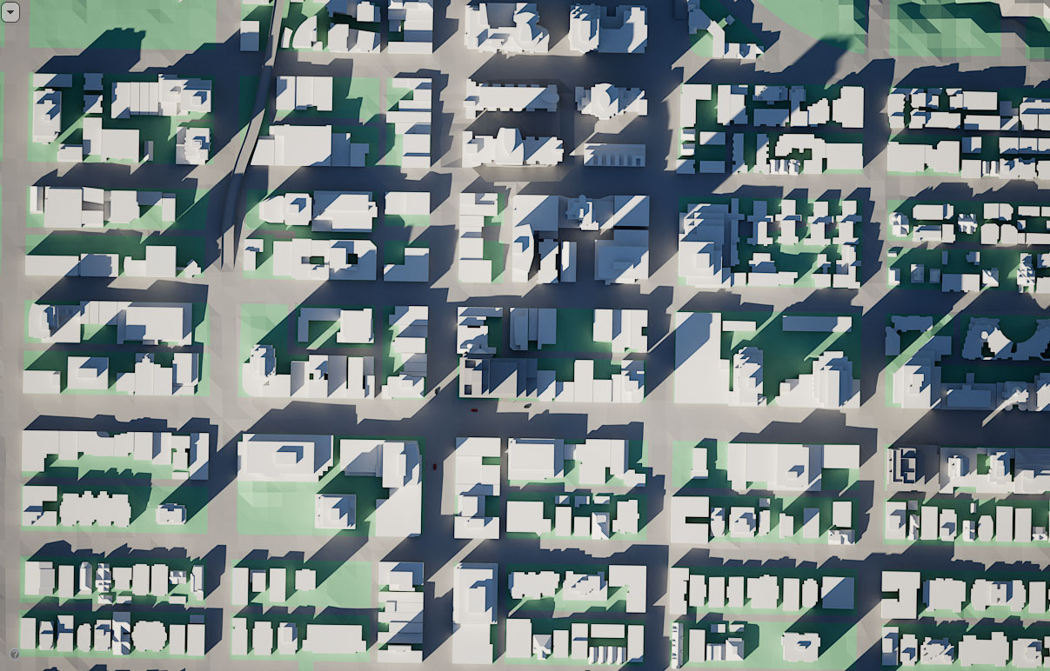
Shadow diagrams
October 15 at 4pm

Slide 33
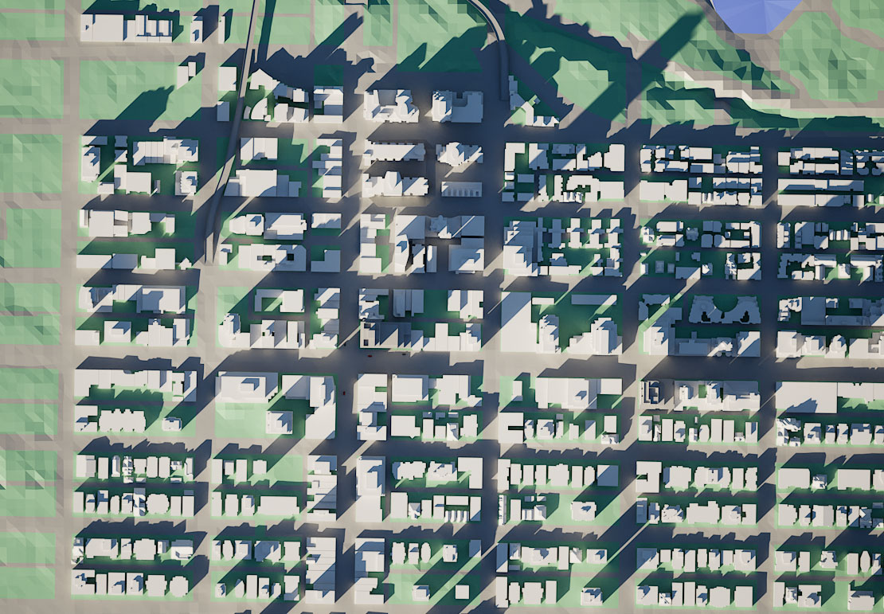
Shadow diagrams
October 28 at 4pm

Slide 34
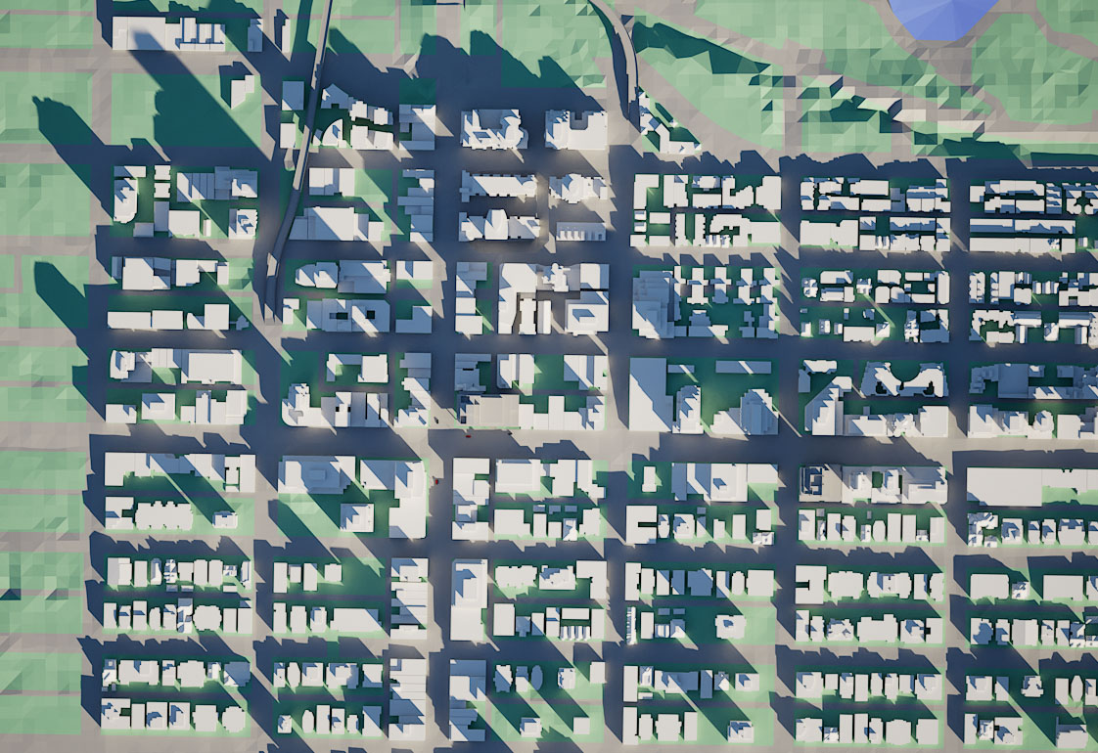
Shadow diagrams
November 5 at 9:12am

Slide 35
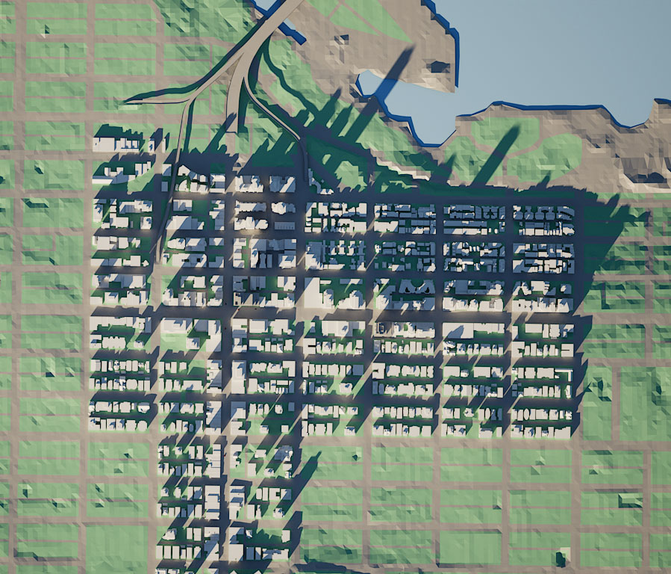
Shadow diagrams
November 28th at 2:30pm

Slide 36
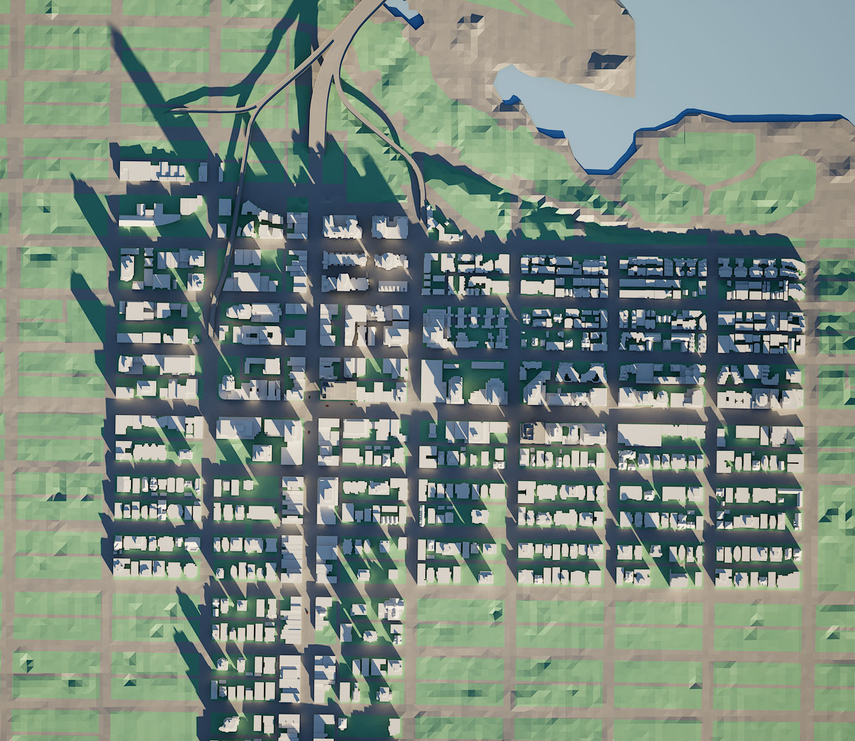
Shadow diagrams
December 21st at 10am

Slide 37
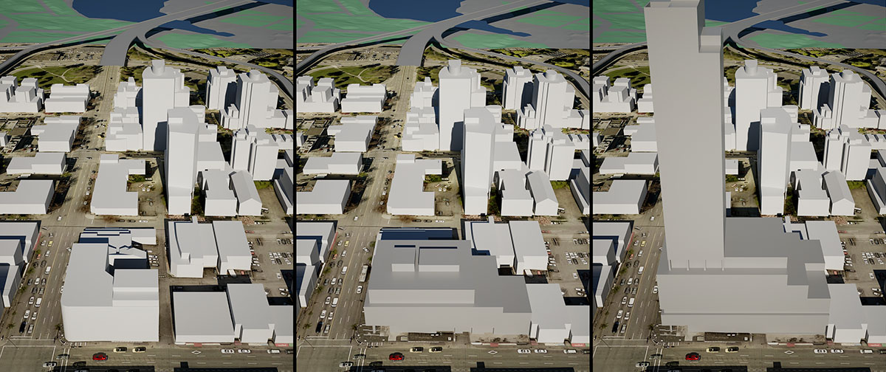
Scale comparison
RBC (left), Development Permit (middle), Rezoning application (right)

Slide 38
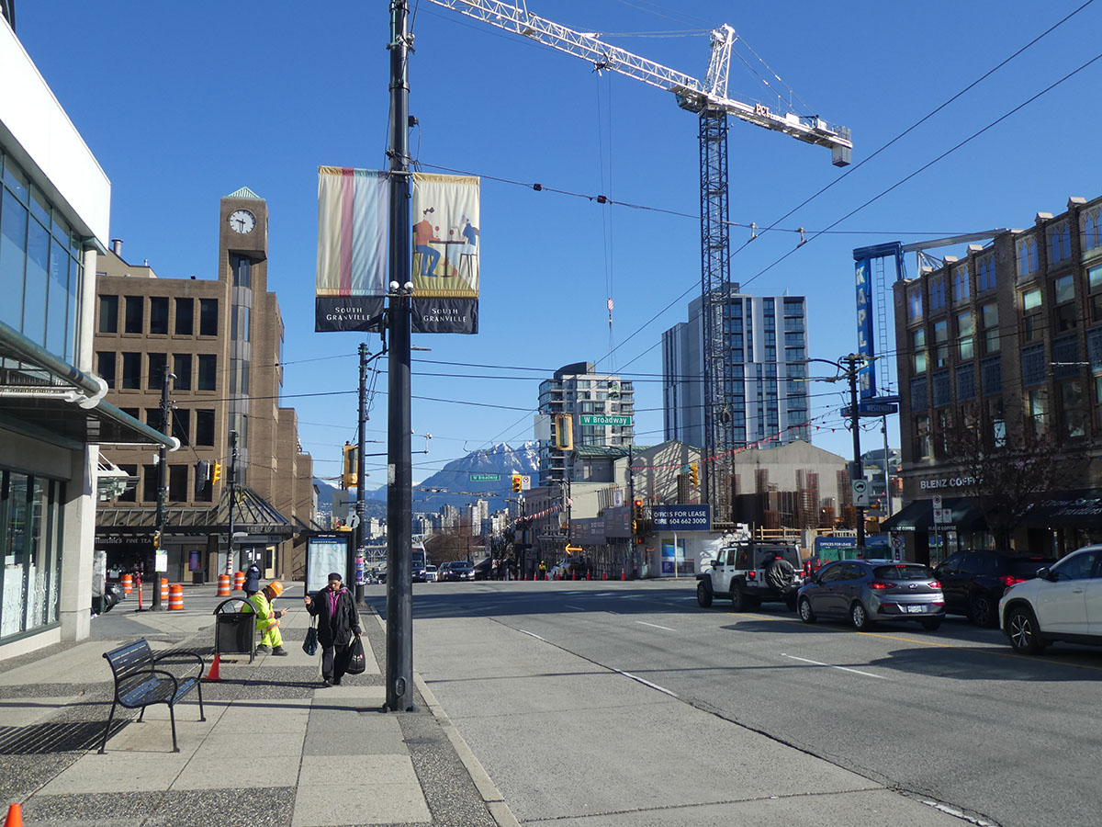
South Granville context
Granville Street

Slide 39
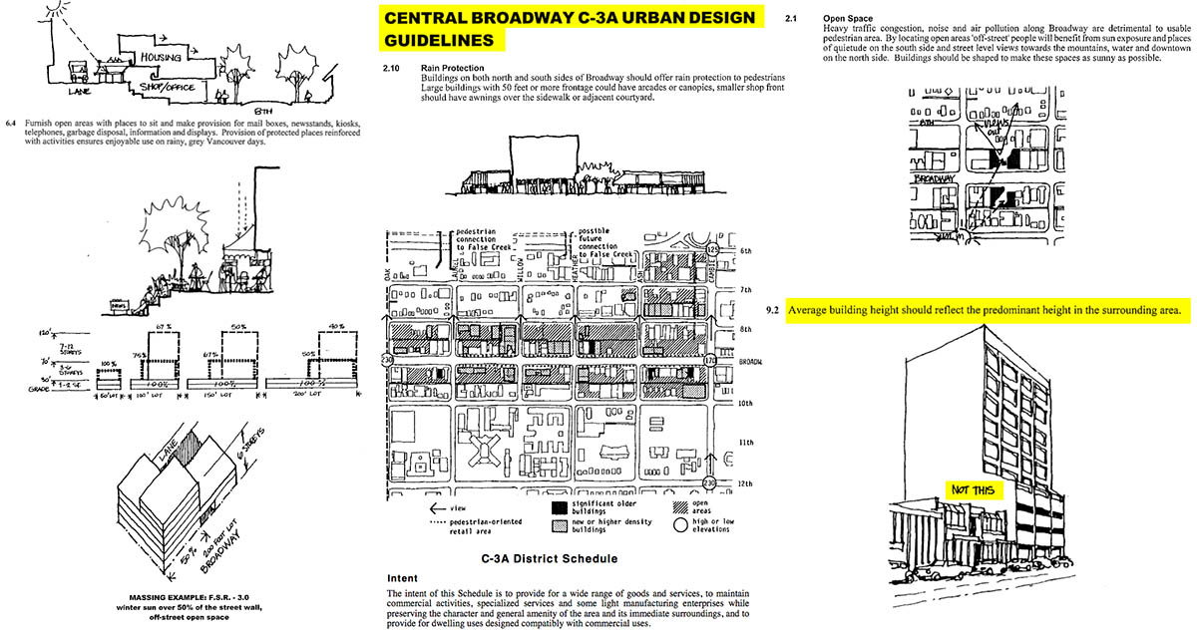
Success of Broadway comes from solid planning, C-3A Design Guidelines and zoning
Acknowledge excellent work done in past

Slide 40
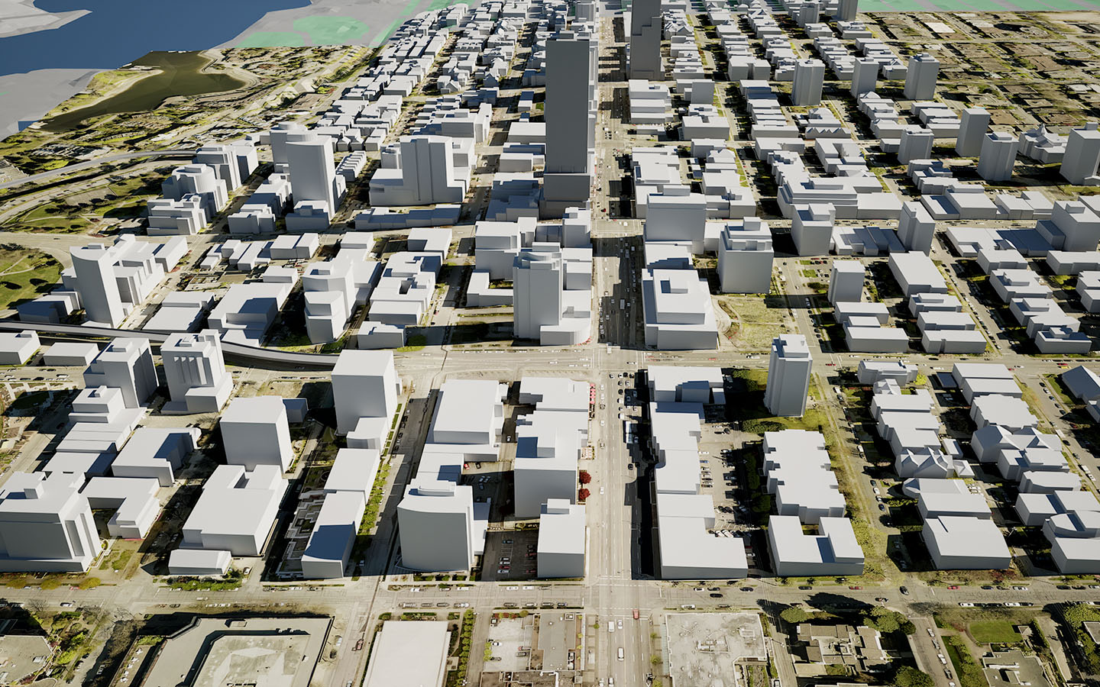
Topographic changes & north facing slope
Massing model, shadows on Oct 21, 12:45pm

Slide 41
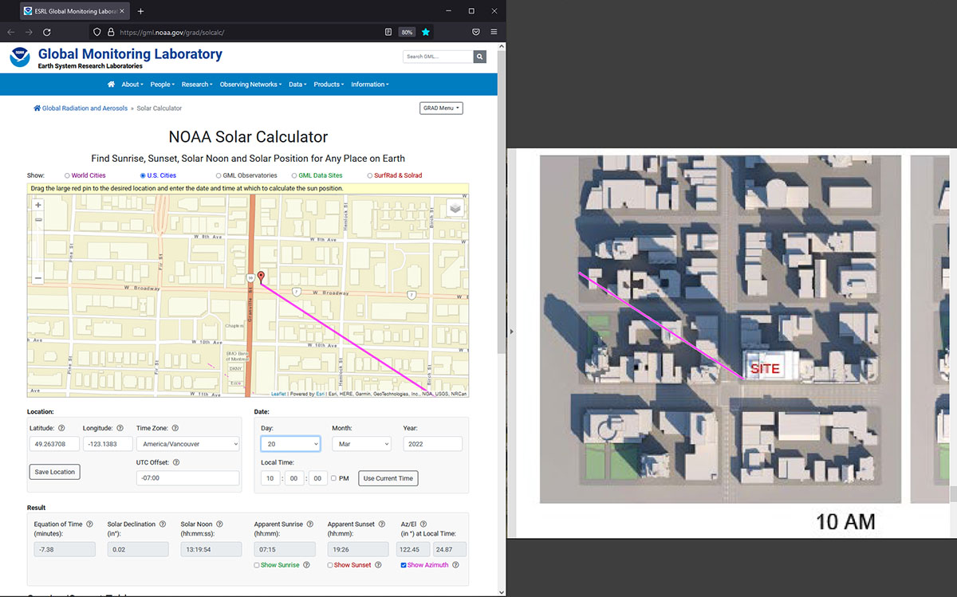
Shadow diagrams on Policy report. Compare with NOAA Solar Calculator

Slide 42
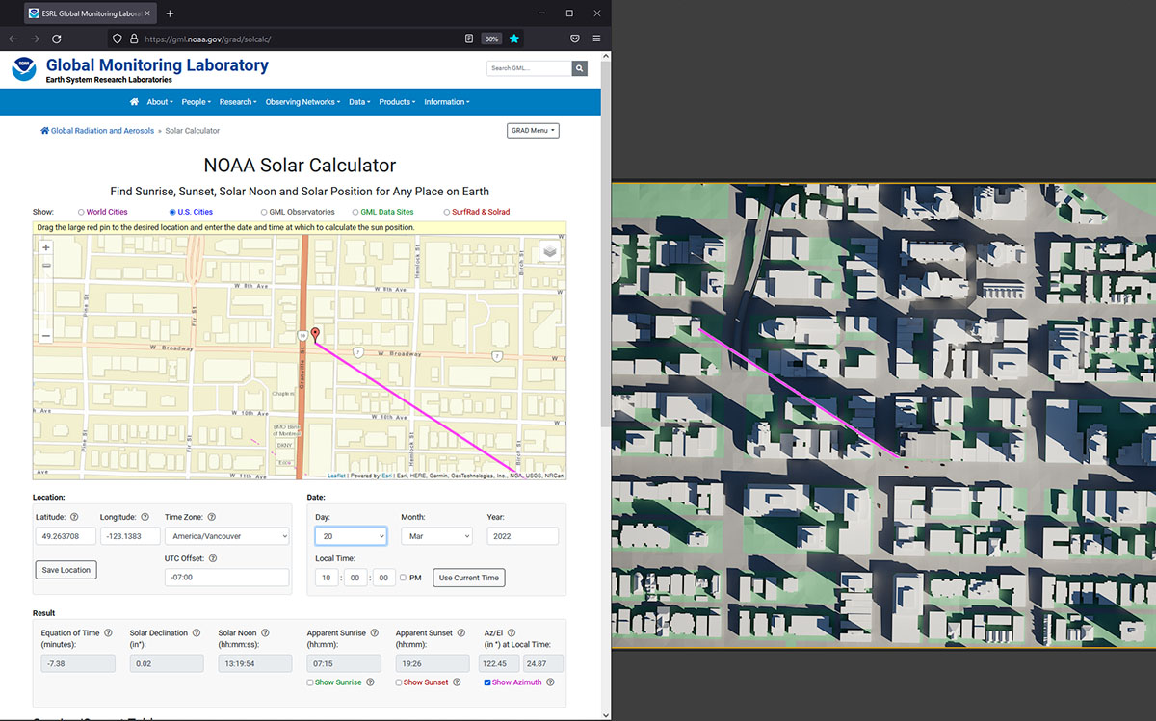
Shadow diagrams (independent). Compare with NOAA Solar Calculator

Slide 43
Shadow diagrams on Policy Report (Appendix D Page 9 of 9)
June 21 at 10am. Compare NOAA, Policy Report and independently generated shadow diagram

